Slide 1
The Pending Changes – a Review of the Imminent Cuts to Accident Benefits
Adam Little
October 20, 2015
@barrie_lawyer

Slide 2
Summary of Changes:
Reduced Limits
New Rules
Narrowed CAT definition
MIG Overhaul

Slide 3
When?
New changes effective June 1, 2016

Slide 4
1 – Reduced Limits

Slide 5
1. Reduced Limits
Effective June 1, 2016:
Non-CAT limits will be reduced to a TOTAL of $65,000 for combined med/rehab and attendant care (down from $86,000 combined total)
CAT limits will be reduced to at TOTAL of $1,000,000 for combined med/rehab and attendant care (down from $2,000,000 combined total)

Slide 6
1. Reduced Limits
Non-Earner Benefit to be limited to 2 years only, with a 4 week waiting period (down from lifetime benefit with 6 month waiting period)

Slide 7
2 – New Rules

Slide 8
2. New Rules
Non-CAT Claims:
$65,000 total limits will apply to both med/rehab and attendant care (no longer $50,000 + $36,000)
Maximum $3,000 per month for AC, for up to 5 years
5 years maximum duration of benefits (down from 10 years), or until age 28 for minors

Slide 9
2. New Rules
Non-CAT Claims:
For “other goods and services” aspect of medical and rehabilitation benefits (see s. 15(1)(h) and 16(2)(l)), will only be paid where “insurer agrees are essential”
These “basket” benefits provisions are basically gone
Notes:
Other goods and services of a medical nature that the insured person requires, other than goods or services for which a benefit is otherwise provided in this Regulation.

Slide 10
3 – Narrowed CAT Definition

Slide 11
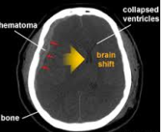
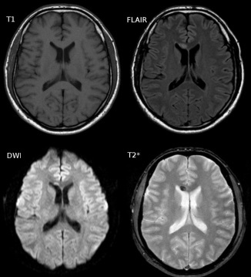
3. Narrowed CAT Definition
GCS criteria eliminated
For TBI, must have “positive findings” on CT or MRI indicating intracranial pathology
Plus GOS or E-GOS of vegetative state (1 month post-MVA), upper or lower severe disability (6 months post-MVA), or lower moderate disability (1 year post-MVA)

Slide 12
3. Narrowed CAT Definition
Minors:
Admission to public hospital with positive findings of intracranial pathology
Admission to neurological rehab in a paediatric rehab facility
King’s Outcome Scale (KOSCHI) testing
At least 9 months post-MVA, level of functioning remains “seriously impaired” (not age-appropriately independent, etc.)

Slide 13
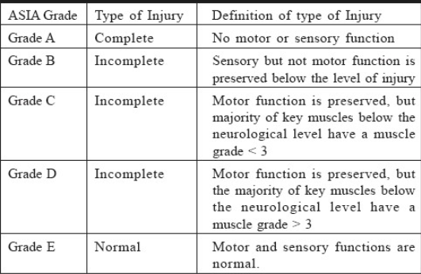
3. Narrowed CAT Definition
Paraplegia and tetraplegia will be determined using the ASIA scale:

Slide 14
3. Narrowed CAT Definition
Grades A, B, or C will automatically trigger CAT benefits
Grade D will require consideration of additional criteria, using Spinal Cord Independence Measure (“SCIM-III”)
In brief, grade D will only be CAT if insured requires crutches or two canes to walk up to 10 metres and must have permanent interference with toileting functions

Slide 15
3. Narrowed CAT Definition
55% whole person impairment remains – or does it?
Slight change in wording of regulation; now refers to 6th edition of the Guides to the Evaluation of Permanent Impairment
6th edition contains SUBSTANTIALLY REDUCED impairment scores for mental and behavioural impairments

Slide 16
3. Narrowed CAT Definition
Mental or behavioural impairment – must have a class 4 marked impairment in 3 or more areas of function, or a class 5 extreme impairment in one or more areas of function

Slide 17
4 – MIG Overhaul

Slide 18
4. MIG Overhaul
Expect replacement of Minor Injury Guideline with Common Traffic Impairment Guideline
Based on FSCO’s report Enabling Recovery from Common Traffic Injuries: A Focus on the Injured Person
Concept of “care pathways”
Concerns include significant funding restrictions, arbitrary timelines for recovery, and inclusion of mild TBI’s

Slide 19
Questions?

Slide 20
The Pending Changes – a Review of the Imminent Cuts to Accident Benefits
Adam Little
October 20, 2015
@barrie_lawyer

