Slide 1
Strategies for Removing your Client from the MIG
Adam Little
October 21, 2015
@barrie_lawyer

Slide 2
Overview
Defining the MIG
Getting out of the MIG
Questions

Slide 3
1 – Defining the MIG

Slide 4
1 – Defining the MIG
MIG initially released in 2010, revised in 2011
A pre-approved process for treating uncomplicated musculoskeletal injuries (the vast majority of MVA claims)
Med/Rehab cap of $3,500
Notes:
Replaced the PAF
The MIG was designed to speed up the process for treatment to start and improve HC resources. It was designed to provide certainty around cost and payouts for insurers and regulated health professionals and be more inclusive in providing immediate benefits without prior approval.
High percentage (80+) of all AB claims are in the MIG

Slide 5
1 – Defining the MIG
No attendant care payable
No in-home assessments payable

Slide 6
1 – Defining the MIG
“minor injury” means one or more of a sprain, strain, whiplash associated disorder, contusion, abrasion, laceration, or subluxation and includes any clinically associated sequelae to such an injury;
“sprain” and “strain” include partial, but not complete, tears

Slide 7
1 – Defining the MIG
MIG applies where impairment is “predominantly a minor injury”
Does not apply if health practitioner provides “compelling evidence” that insured has “a pre-existing medical condition that will prevent the insured person from achieving maximal recovery” if subjected to $3,500 cap

Slide 8
1 – Defining the MIG
What is “compelling evidence”?
Scarlett v. Belair Insurance (Div. Ct.):
“Compelling” is directed at sufficiency of evidence
Whether evidence meets the test of “compelling” must be determined on the facts of each individual case

Slide 9
2 – Getting Out of the MIG

Slide 10
2 – Getting Out of the MIG
Timely submission of “compelling evidence” of pre-existing medical condition (using OCF-18 with attached medical documents, if any)
Prevention from achieving maximal recovery is key factor
Notes:
However – note that MIG says the existence of a pre-existing condition will not automatically exclude a person. It is intended and expected that the vast majority of pre-existing conditions will not do so.

Slide 11
2 – Getting Out of the MIG
Complete the OCF-3 Disability Certificate with a view to non-MIG injuries:
List injuries in order of significance, with soft tissue injuries generally last
Mild TBI or concussion first
Are there psychological or neurological impairments which can be included?

Slide 12
2 – Getting Out of the MIG
Chronic Pain Disorder is not a MIG impairment!
Arruda v. Western Assurance Company (recent FSCO arb.)

Slide 13
2 – Getting Out of the MIG
Have the lawyer obtain an expert report:
Notes:
Client sustained blunt neck trauma in motorcycle accident. Resulted in persistent raspy voice caused by immobile vocal cord, and permanent partial airway obstruction of 30-40%.
Insurer said it was a soft tissue injury, and applied the MIG.

Slide 14
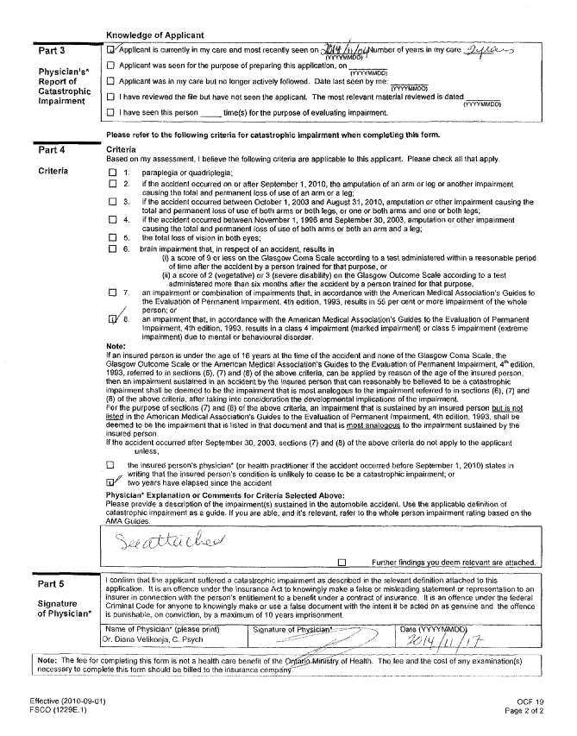
2 – Getting Out of the MIG
Prove impairment is Catastrophic:
Notes:
Client sustained blunt neck trauma in motorcycle accident. Resulted in persistent raspy voice caused by immobile vocal cord, and permanent partial airway obstruction of 30-40%.
Insurer said it was a soft tissue injury, and applied the MIG.

Slide 15
2 – Getting Out of the MIG
Notes:
Client sustained blunt neck trauma in motorcycle accident. Resulted in persistent raspy voice caused by immobile vocal cord, and permanent partial airway obstruction of 30-40%.
Insurer said it was a soft tissue injury, and applied the MIG.

Slide 16
2 – Getting Out of the MIG
What else can you do?:
Adopt a compelling and persuasive tone in your reports
Just say it: “not a minor injury”
Humanize the patient and the impact of the injuries on their quality of life / ADL’s
Cooperate and form a relationship with the adjuster

Slide 17
2 – Getting Out of the MIG
Reinforce idea that treatment can minimize exposure and avoid future costs
Work closely with law firm / Accident Benefits Specialists to maximize benefits and outcome
DON’T BACK DOWN!

Slide 18
3 – Questions?

Slide 19
Strategies for Removing your Client from the MIG
Adam Little
October 21, 2015
@barrie_lawyer

