Slide 1
Collaborative Solutions for School Integration Following Pediatric Traumatic Brian Injury
Practical Strategies Conference - April 21, 2016
Moderator:
Patrick Brown – Partner, McLeish Orlando
Panelists:
Sara Diederichs - Community Resource Teacher-Secondary, Bloorview School Authority
Christine Kalkanis - Treatment Provider, Post Traumatic Rehabilitation Services
Mary Anderson - Case Manager, KIDS Community Health Services

Slide 2
@ Holland Bloorview Kids Rehabilitation Hospital
Presenter: Sara Diederichs
Community Resource Teacher – Secondary
416-425-6220 x3205
sdiederichs@hollandbloorview.ca

Slide 3
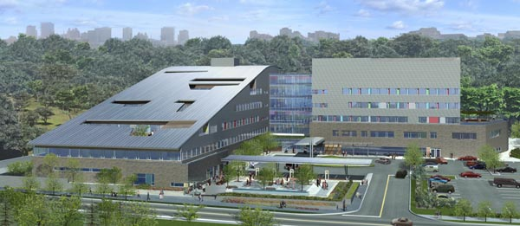

Slide 4
Community Resource Teachers (CRTs)
The primary role of CRTs is to provide collaborative planning and resource support that facilitates school transition and successful reintegration into community schools post-discharge from HBKRH.

Slide 5
Community Resource Teachers - What Do We Do?
Community Resource Teachers (CRTs) provide service to children and youth clients of Holland Bloorview Kids Rehabilitation Hospital (HBKRH).
CRT school transition planning support is available to inpatient clients who require intensive rehab as a result of an Acquired Brain Injury, surgery, or chronic illness, and to outpatient clients with complex physical, communication, learning or medical challenges that impact educational planning.
CRTs collaborate with and provide consultative services to families, HBKRH teams, classroom teachers, school board personnel, community teams and organizations (e.g. private teams, CCAC).

Slide 6
Community Resource Teachers Who Is Eligible?
Any client of Holland Bloorview Kids Rehab Hospital requiring transitional planning support can be referred for CRT service.
Transitional support is available for primary, elementary, middle-school and secondary school-aged youth.
Direct service in GTA and consultation beyond.

Slide 7
Community Resource Teachers When Is Support Needed?
After and during hospital during admission (e.g. Family Team Meetings)
At time of discharge*
Post-discharge (usually for a period of one year)
At periods of key school transition

Slide 8
Community Resource Teachers Key Transitions…
Hospital to School
Entry into School (pre-school, Grade 1)
8-to-9 Transition
Transition to Post-Secondary
Change of school placement
Change of level of support
Change of school program

Slide 9
Presenter: Christine Kalkanis
Treatment Provider
www.ptrs.ca

Slide 10
Case management procedures
Contact Legal Guardian at Point of Initial Referral
Answer Initial Questions-“Who are You”? What is Your Role”?
Confirm On-Site Meeting
Generate a Comprehensive Understanding of Client Pre-Accident Functioning and Post-Accident Needs
Contact the facility’s Assigned Discharge Planner and/or Social Worker
Advocate Community Team Members to Attend Early Team Meetings if Possible

Slide 11
General Team members beyond case management
Psychology
Occupational Therapy
Speech and Language Pathology
Physiotherapy
Rehabilitation Support Worker
Educational Specialist

Slide 12
Team cohesion
Goal is to Strengthen Long-Term Success Outcome

Slide 13
Transitional support without somebody as great as sara?
Same Steps as Above if Funding Permits
Case Manager to Contact School Officials-Get Process Going
Accessible Learning Services/Student Wellness

Slide 14
Success stories
Cohesive Teams
Attending Family Team Meetings as Soon as Possible
Early Treatment Plan Submissions
Connect with The Principal (or appropriate professional) of Home School
Encourage Open Communication Between Community Team and Home School Supports
Confirm Initial Home School Team Following Discharge for Education and IPRC
Positive Playing Field = Positive Outcome…Usually…

Slide 15
Complex stories Christine Kalkanis
Funding Restrictions-Both Private and/or Public
Poor Team Cohesion
Possible Restrictions Within Board

Slide 16
Presenter: Mary Anderson
Case Manager, School Integration Specialist
(519)645-7749
mary.anderson@kidscommunityhs.ca
www.kidscommunityhs.com

Slide 17
School Integration: Long term implications

Slide 18
Factors that will Enhance a Positive School Integration experience
Well informed parents
Well informed educators
Student will understand their learning needs, abilities, and limitations
Student will accept accommodations and the need to adopt compensatory strategies
Adequate and variable support at school and at home

Slide 19
The School Integration Process
Educate
Listen & Learn
Anticipate & Plan
Create solutions/negotiate
Monitor
Evaluate & Adjust

Slide 20
Strategies to promote effective communication with school personnel
Develop a good rapport with the classroom teacher and the Special Education/Resource Teacher
Be cognisant of educators’ schedules and their responsibilities to other students
Introduce recommendations creatively

Slide 21
Educations to Teachers is Necessary
Ensure a good understanding of the student’s learning, physical, social, and behavioural needs and how to help them overcome their limitations
Instill a good understanding of required accommodations, realistic expectations, compensatory strategies, and how to implement them within the classroom environment
Equip them with the knowledge to be able to recognize developing problems, who can assist, and the importance of early intervention

Slide 22
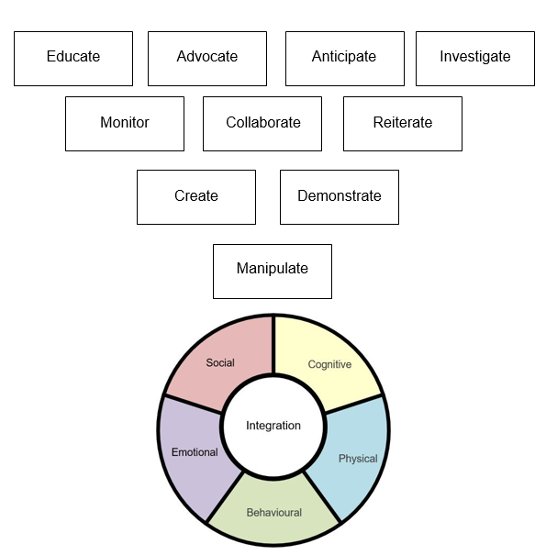
Necessary actions to integrate students

Slide 23
School integration resources

Slide 24
Questions?

