Slide 1
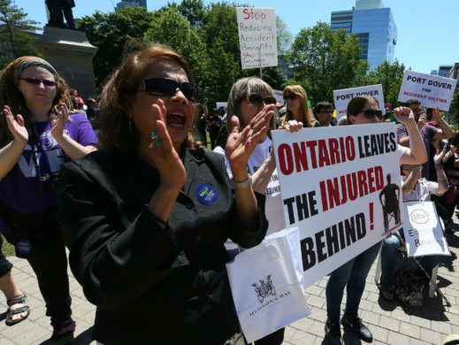
More Cuts to Accident Benefits – Strategies for Survival
Adam Little &
Steven Smyth
May 3, 2016
@barrie_lawyer

Slide 2
Summary of Changes:
Reduced Limits
New Rules
Licence Appeals Tribunal
MIG Overhaul
Tort Changes

Slide 3
When?
SABS changes effective June 1, 2016
Applicable at time of policy renewal

Slide 4
1 – Reduced Limits

Slide 5
1. Reduced Limits
Effective June 1, 2016:
Non-CAT limits will be reduced to a TOTAL of $65,000 for combined med/rehab and attendant care (down from $86,000 combined total)
CAT limits will be reduced to at TOTAL of $1,000,000 for combined med/rehab and attendant care (down from $2,000,000 combined total)

Slide 6
1. Reduced Limits
Strategies:
Careful use of available funds
What therapies will give the most “bang for the buck”?
Avoid any potential overlap between treatment providers

Slide 7
1. Reduced Limits
Strategies:
Spread the word: OPTIONAL BENEFITS!

Slide 8
1. Reduced Limits
Non-Earner Benefit to be limited to 2 years only, with a 4 week waiting period (down from lifetime benefit with 6 month waiting period)
Means a maximum total of $18,500 for Non-Earner Benefits!

Slide 9
1. Reduced Limits
Strategies:
???

Slide 10
1. Reduced Limits
Strategies:
???
Spread the word: OPTIONAL BENEFITS!

Slide 11
2 – New Rules

Slide 12
2. New Rules
Non-CAT Claims:
$65,000 total limits will apply to both med/rehab and attendant care (no longer $50,000 + $36,000)
Maximum $3,000 per month for AC, for up to 5 years
5 years maximum duration of benefits (down from 10 years), or until age 28 for minors

Slide 13
2. New Rules
Strategies:
Focus on the area of most significant need (eg. attendant care where safety is an issue)

Slide 14
2. New Rules
Strategies:
Spread the word: OPTIONAL BENEFITS!

Slide 15
2. New Rules
For “other goods and services” aspect of medical and rehabilitation benefits (see s. 15(1)(h) and 16(2)(l)), will only be paid where “insurer agrees are essential”
These “basket” benefits provisions are basically gone
Notes:
Other goods and services of a medical nature that the insured person requires, other than goods or services for which a benefit is otherwise provided in this Regulation.

Slide 16
2. New Rules
Strategies:
Where available, focus on tort claim for items that do not fall directly within ss. 15-16 of the SABS

Slide 17
2. New Rules
Strategies:
Spread the word: OPTIONAL BENEFITS!

Slide 18
3 – Licence Appeal Tribunal

Slide 19
3. Licence Appeal Tribunal
Effective April 1, 2016
Right to sue AB insurer is eliminated
FSCO mediations and arbitrations are eliminated

Slide 20
3. Licence Appeals Tribunal
“Automobile Accident Benefits Service” [AABS] procedure at the Licence Appeals Tribunal
LAT experienced with:
liquor licence issues
new home warranty claims
medical suspension of driver’s licences
How will LAT deal with SABS disputes?

Slide 21
3. Licence Appeals Tribunal
Process designed to move quickly
Case conference within 45 days
Hearings within 60 days of case conference
Expedited resolution process, but at the expense of justice?
No general rule for payment of costs or expenses

Slide 22
3. Licence Appeals Tribunal
Strategies:
Push EVERYTHING POSSIBLE to the LAT
Challenge the rules and tear down the boundaries to beat the insurers at their own game
Be selective and conservative (but forceful) with expert reports and witnesses
Make insurers regret their successful lobbying efforts

Slide 23
4 – MIG Overhaul?

Slide 24
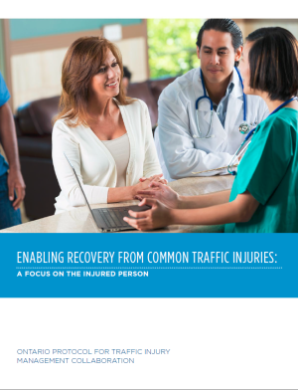
4. MIG Overhaul?
Expect replacement of Minor Injury Guideline with Common Traffic Impairment Guideline – implementation not yet announced / confirmed
Based on FSCO’s report Enabling Recovery from Common Traffic Injuries: A Focus on the Injured Person

Slide 25
4. MIG Overhaul?
Concept of “care pathways”
Concerns include significant funding restrictions, arbitrary timelines for recovery, and inclusion of mild TBI’s
No firm details as yet, and no implementation date

Slide 26
5 – Tort Changes

Slide 27
5. Tort Changes
Effective NOW (Since August 1, 2015)

Slide 28
5. Tort Changes
Previously:
$30,000 deductible for primary claim
(vanishes for claims > $100,000)
$15,000 deductible for FLA claims
(vanishes for claims > $50,000)
No deductible for fatal accidents
Pre-judgment interest at 5% per year for pain and suffering damages

Slide 29
5. Tort Changes
Now:
$36,905.40 deductible for primary claim
(vanishes for claims > $123,106.99)
$18,452.70 deductible for FLA claims
(vanishes for claims > $61,507.99)
No deductible for fatal accidents
Will be revised every January to account for inflation

Slide 30
5. Tort Changes
Now:
Pre-judgment interest at pecuniary rate (~1.5%)

Slide 31
Questions?

Slide 32
More Cuts to Accident Benefits – Strategies for Survival
Adam Little &
Steven Smyth
May 3, 2016
@barrie_lawyer

