Slide 1
Changes to the Definition of Catastrophic Impairment
James L. Vigmond

Slide 2
All accident benefit changes effective June 1, 2016
Ontario Regulation 251/15 released August 27, 2015

Slide 3
Reduction in total benefits for non-catastrophic claims
Accidents on and after June 1, 2016.
New total maximum medical/rehabilitation and attendant care = $65,000. Previously $86,000.
Duration reduced from 10 years to 5 years for adults. Age 28 for children.
$65,000 can be spent on either AC or MR ($3k per month AC cap).

Slide 4
Reduction in Non-Earner Benefits
Eligibility for non‐earner benefits reduced from ‘life’ to a maximum duration of 2 years (four week waiting period).
Maximum $18,500 over their lifetime ($185 per week for 2 years, other than during the first four weeks) instead of a lifetime of access.

Slide 5
Reduction in Catastrophic Benefits
Currently $1mm for AC and $1mm for MR. As of June 1, 2016 – total of $1mm for both combined over lifetime.
Changes only apply to accidents on or after June 1, 2016.

Slide 6
Narrowed CAT definition
Introduction of new tests
Elimination of GCS
Effect is to create delay, confusion and uncertainty.
Dramatically reduce the number of insured who are CAT.

Slide 7
GCS
Eliminated
Created bright white line allowing immediate access to benefits
Tenuous relationship to outcome/need

Slide 8
Paraplegia or Tetraplegia
Will now be defined by the insured permanent grade on the ASIA Impairment Scale (American Spinal Injury Association)

Slide 9
Paraplegia or Tetraplegia
Grade | Definition
A | Complete. No sensory or motor function is preserved in the sacral segments S4-S5
B | Incomplete. Sensory but no motor function is preserved below the neurological level and includes the sacral segments S4–S5
C | Incomplete. Motor function is preserved below the neurological level, and more than half of key muscles below the neurological level have a muscle grade less than 3 (Grades -02).
D | Incomplete. Motor function is preserved below the neurological level, and at least half of key muscles below he neurological level have a muscle grade greater than or equal to 3.
E | Normal. Sensory and motor functions are normal.
Included

Slide 10
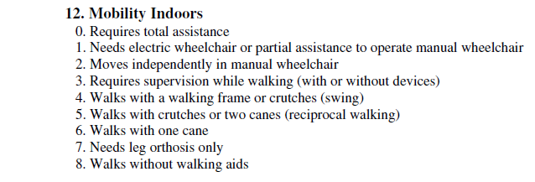
Paraplegia or Tetraplegia
ASIA D qualifies in 1 of 3 ways:
Mobility (indoors and outdoors, on even surface)
If can walk (aided) a distance of up to 10 meters on an even indoor surface??
CAT

Slide 11
Paraplegia or Tetraplegia
Insured requires urological surgical diversion, an implanted device or catheterization to manage urological impairment.
Insured requires a bowel routine, a surgical diversion or an implanted device to manage anorectal function.

Slide 12
Mobility impairment (non spinal cord)
(1)2. Severe impairment of ambulatory mobility or use of an arm, or amputation that meets the following criteria:
Trans-tibial or higher amputation of a leg.
Amputation of an arm or another impairment causing the total and permanent loss of use of an arm.

Slide 13
Mobility impairment (non spinal cord)
Mobility (indoors and outdoors, on even surface)
CAT
If can walk (aided) a distance of up to 10 meters on an even indoor surface??

Slide 14
Blindness
(1) 3. Loss of vision of both eyes that meets the following criteria:
Even with the use of corrective lenses or medication,
Visual acuity in both eyes is 20/200 (6/60) or less as measured by the Snellen Chart or an equivalent chart, or
The greatest diameter of the field of vision in both eyes is 20 degrees or less.
The loss of vision is not attributable to non-organic causes.

Slide 15
Adult Traumatic Brain Injury
(1)4. If the insured person was 18 years of age or older at the time of the accident, a traumatic brain injury that meets the following criteria:
The injury shows positive findings on a computerized axial tomography scan, a magnetic resonance imaging or any other medically recognized brain diagnostic technology indicating intracranial pathology that is a result of the accident, including, but not limited to, intracranial contusions or haemorrhages, diffuse axonal injury, cerebral edema, midline shift or pneumocephaly.

Slide 16
Adult Traumatic Brain Injury
When assessed in accordance with Wilson J., Pettigrew, L. and Teasdale, G., Structured Interviews for the Glasgow Outcome Scale and the Extended Glasgow Outcome Scale and the Extended Glasgow Outcome Scale: Guidelines for Their Use, Journal of Neurotrauma, Volume 15, Number 8, 1998, the Injury results in a rating of,

Slide 17
Adult Traumatic Brain Injury
Vegetative State (VS or VS*), one month or more after the accident,
Upper Severe Disability (Upper SD or Upper SD*) or Lower Severe Disability (Lower SD or Lower SD*, six months or more after the accident, or
Lower Moderate Disability (Lower MD or Lower MD*), one year or more after the accident.

Slide 18
Adult Traumatic Brain Injury
The Glasgow Outcome Scale (GOS) is a global scale for functional outcome that rates a patient status into one of five categories: Dead, Vegetative State, Severe Disability, Moderate Disability or Good Recovery. The Extended GOS (GOSE) provides more detailed categorization into eight categories by subdividing the categories into lower and upper categories.

Slide 19
Glasgow Outcome Scale Extended*
Category | GOSE Descriptor |  | Key Features
1 | Dead | D
2 | Vegetative State | VS | Unable to obey commands or say words
3 | Severe Disability - Lower | SD - | Needs frequent help or someone to be around most of the time
4 | Severe Disability – Upper | SD + | Does not need frequent help able to be alone at home for up to 8 hrs. Not able to shop without assistance Not able to travel locally without assistance
5 | Moderate Disability – Lower | MD - | Not able to work, or only in a sheltered or non-competitive position Unable to participate (or, rarely if even) in regular social and leisure activities outside home Constant and intolerable (daily) disruption or family relationships or friendships due to psychological problems
6 | Moderate Disability – Upper | MD + | Able to work or study but at a reduced capacity Participates much less (less than half as often) in regular social and leisure activities outside home Frequent but tolerable (once per week) disruption of family relationships or friendships due to psychological problems
7 | Good Recovery – Lower | GR - | Participates at least half as often as before in regular social and leisure activities outside home Occasional disruption of family relationships or friendships due to psychological problems Other problems relating to the injury (headache, dizziness, tiredness, sensory sensitivity, slowness, memory failures, concentration problems) affect daily life
8 | Good Recovery - Upper | GR + | Able to work to previous capacity Able to resume regular social and leisure activities outside home No psychological problems resulting in ongoing family disruption or disruption to friendships

Slide 20
GOSE (Glasgow Outcome Scale-Extended)
Emphasis is on functional outcome and not initial severity
Notes:
20

Slide 21
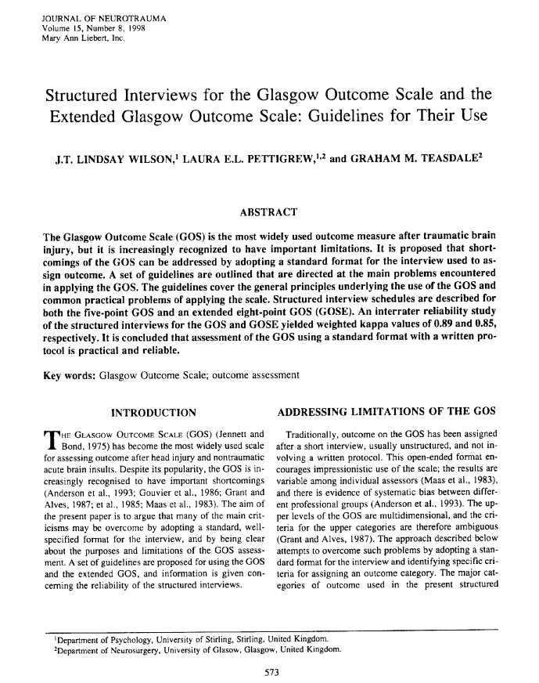

Slide 22
GOSE (Glasgow Outcome Scale-Extended)
“The approach suggested here is to rate such people on their current functional status and to indicate the existence of preinjury disability by putting a * beside the rating.”
There is no instruction to apportion or subtract pre-accident disability level.
Query use of material contribution test
Notes:
22

Slide 23
GOSE (Glasgow Outcome Scale-Extended)
“Disability must be a result of physical or mental impairment.”
But the definition requires a “traumatic brain injury.”
Client must be assessed using Structured Interviews
Notes:
23

Slide 24
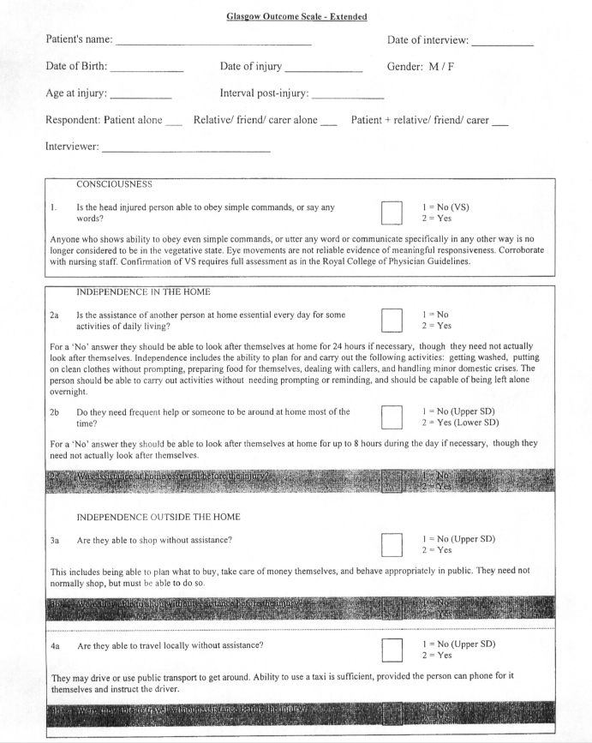

Slide 25
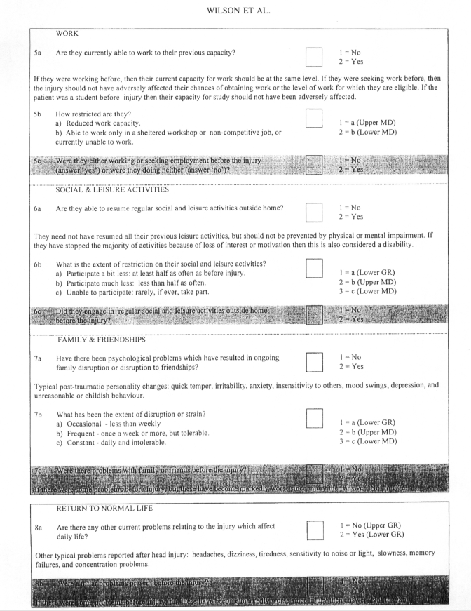

Slide 26
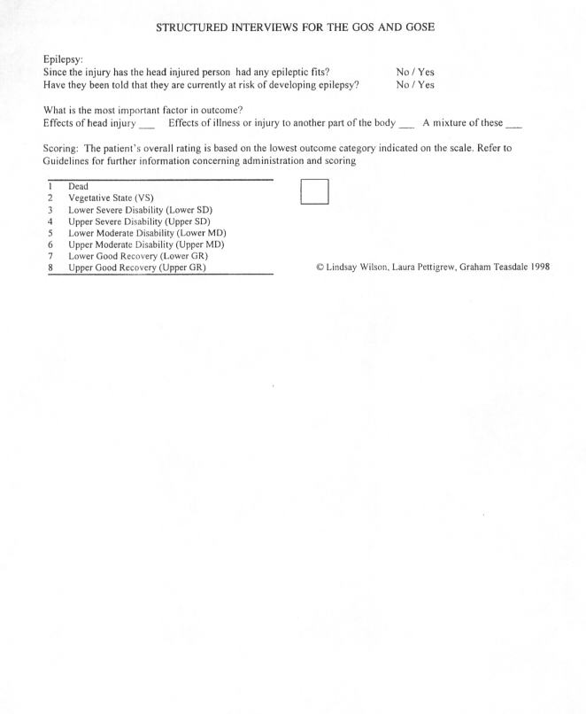

Slide 27
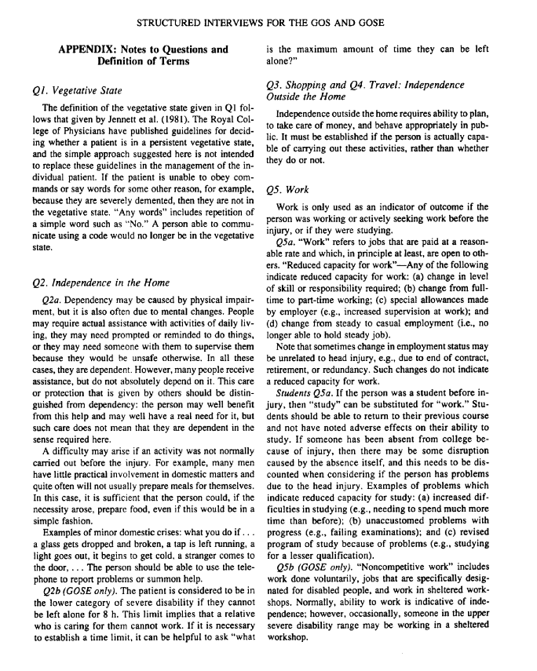

Slide 28
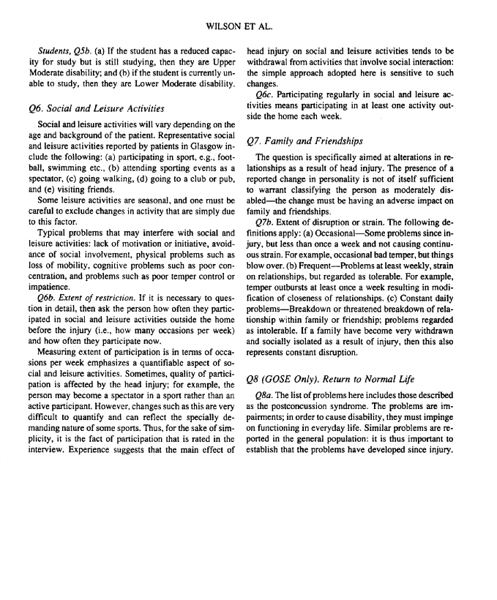

Slide 29
How will it work
GOSE has 8 levels of impairment vs 6 of GOS
Patient assessed at 1, 6, or 12 months
Use of “Upper” and “Lower” categories
Lower = lower function
At 1 month – Vegetative State
At 6 months – Severe Disability
At 12 months – Lower Moderate Disability
Notes:
29

Slide 30
definitions
Consider use of concepts of “meaningful” and “qualitative” in a subjective context
Reject literal and quantitative analyses
Notes:
30

Slide 31
Mtbi and gose
Notes:
31

Slide 32
Paediatric Brain Injury
-Requires 1 of:
Insured is accepted for admission on an in-patient basis to a public hospital with positive findings on imaging.
Insured is accepted for admission to an in-patient neuro rehab paediatric program.
Meets the KOSCHI (King’s Outcome Scale for Childhood Head Injury) Vegetative after 1 month.

Slide 33
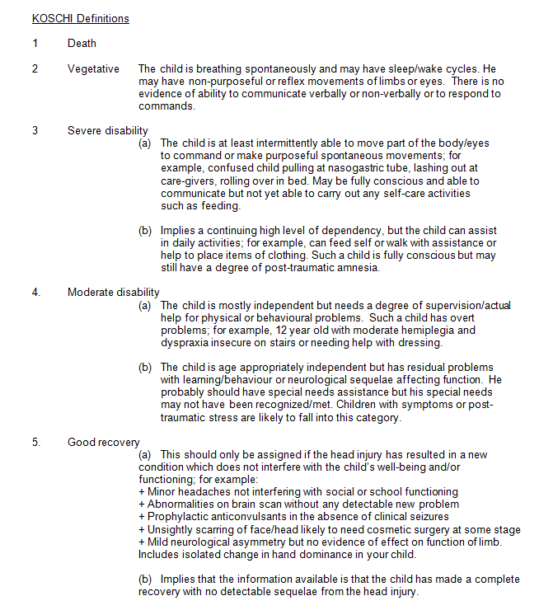

Slide 34
Paediatric Brain Injury
Meets the KOSCHI Severe Disability after 6 months

Slide 36
Paediatric Brain Injury
Nine months or more after the accident, the insured person’s level of function remains seriously impaired such that the insured person is not age-appropriately independent and requires in-person supervision or assistance for physical, cognitive or behavioural impairments for the majority of the insured person’s waking day.

Slide 37
55% Whole Person Impairment (WPI)
Continue to combine physical and mental/behavioural impairments.
Excludes traumatic brain injury.
Utilize the AMA Guides to the Evaluation of Permanent Impairment 6th edition for rating.

Slide 38
55% Whole Person Impairment (WPI)
Utilize the Guides 4th edition for combining scores.
Effect is to dramatically reduce % rating for mental/behavioural impairments.
Must wait 2 years unless will obviously always be CAT.

Slide 39
Rating mental and behavioural disorders under the 6th edition
New GAF/GAF Impairment Score Conversion Table
The Brief Psychiatric Rating Scale (BPRS)
The Psychiatric Impairment Rating Scale (PIRS)
Drastically and unscientifically reduce impairment ratings
Need physical WPI of to reach the 55% WPI when the mental disorder is severe (GAF of 40-50)
47%
Notes:
39

Slide 40
Method of impairment rating
Step 1 – determine BPRS Impairment Score
Notes:
40

Slide 41
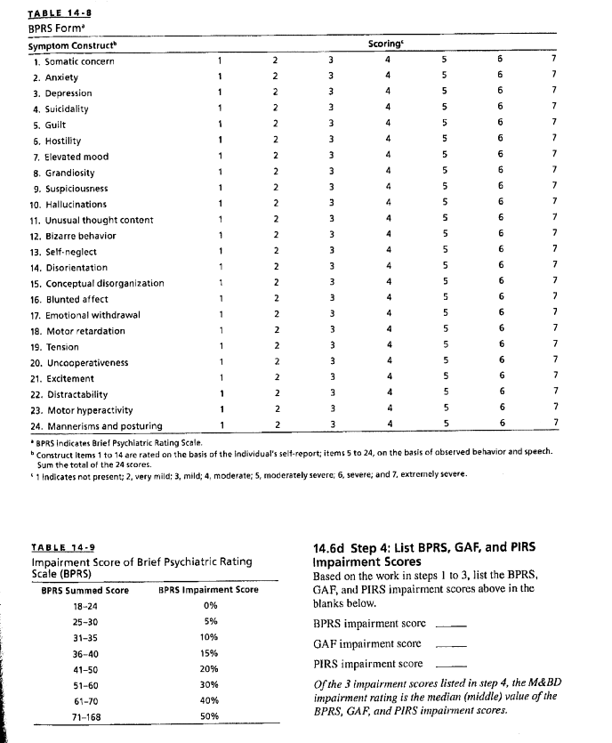

Slide 42
The brief psychiatric rating scale (bprs)
BPRS focus is solely on symptom severity
Notes:
42

Slide 43
Method of impairment rating
Step 1 – determine BPRS Impairment Score
Step 2 – determine GAF Impairment Score
Notes:
43

Slide 44
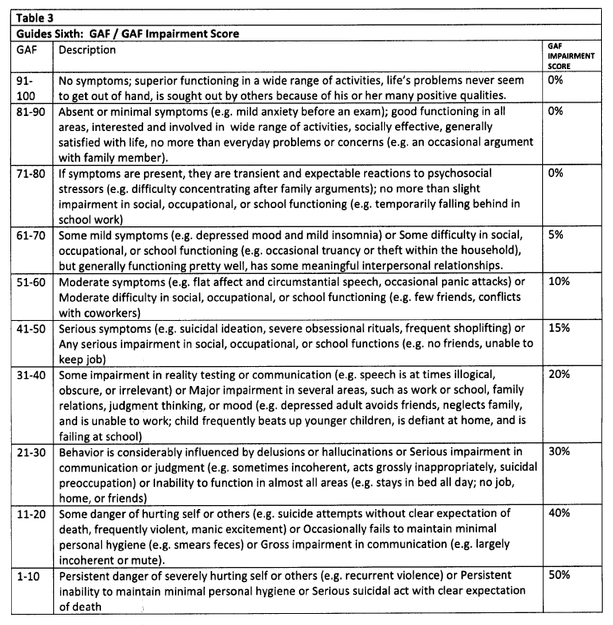

Slide 45
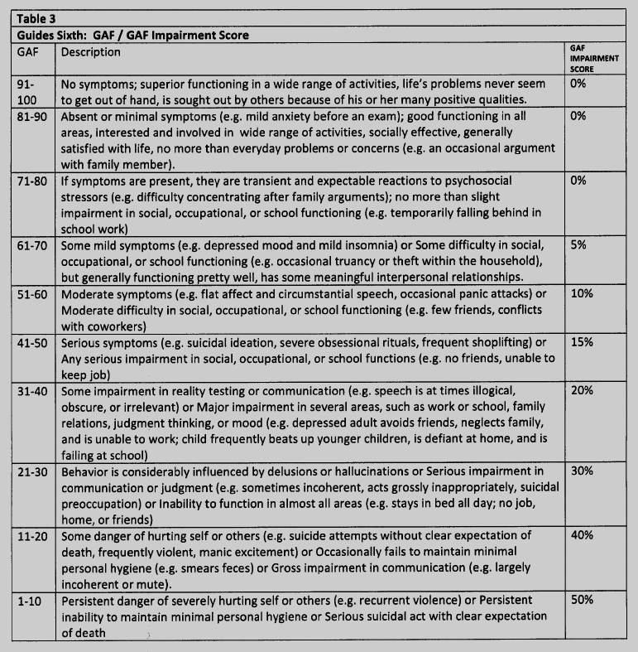

Slide 46
Global Assessment of functioning (gaf)
GAF is based only on psychological, social and occupational functioning
Notes:
46

Slide 47
Method of impairment rating
Step 1 – determine BPRS Impairment Score
Step 2 – determine GAF Impairment Score
Step 3 – determine PIRS Impairment Score
Notes:
47

Slide 49
psychiatric impairment rating scale (pirs)
PIRS focus is role function
Notes:
49

Slide 50
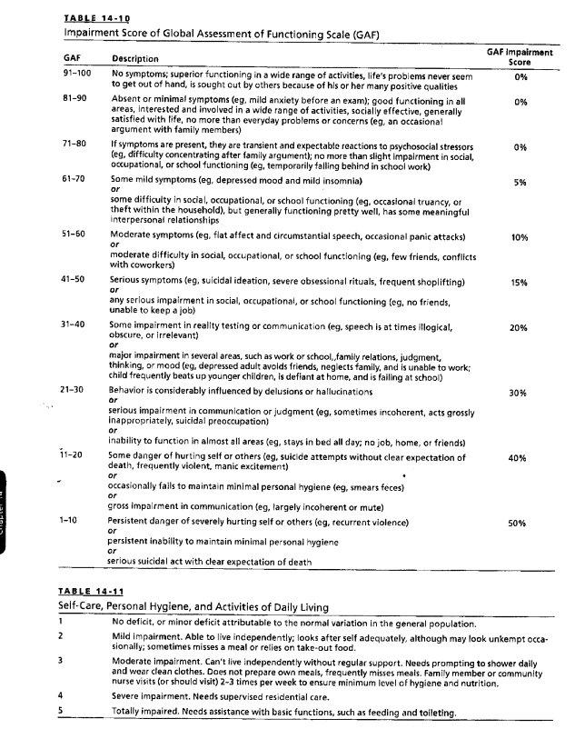

Slide 51
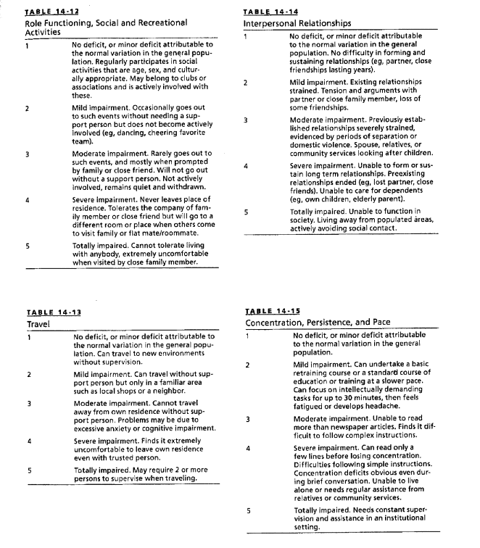

Slide 52
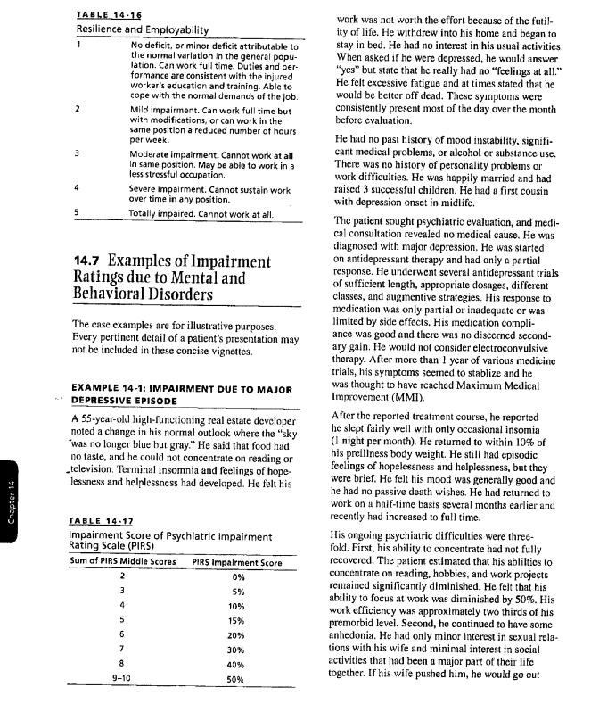

Slide 54
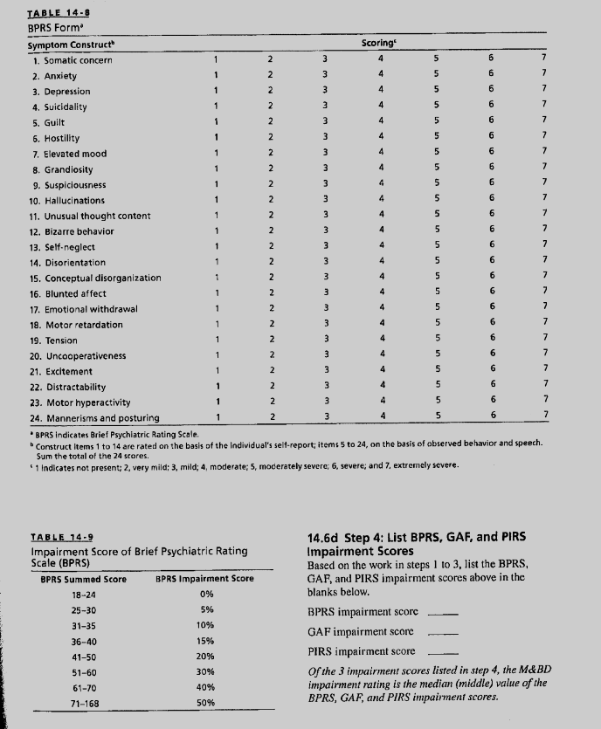
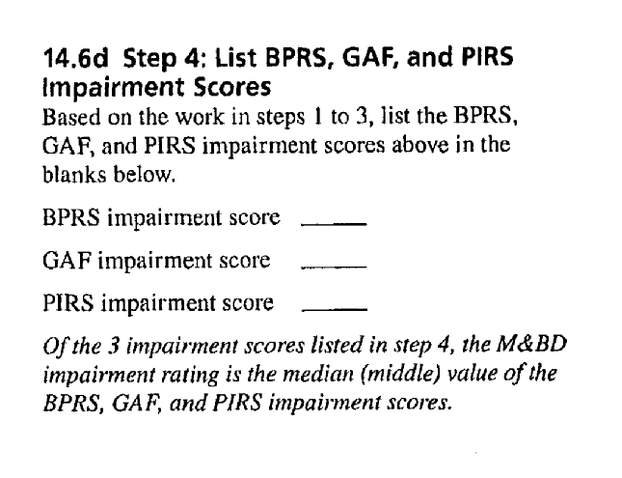

Slide 55
Psychiatric Impairment
Requires 3 Class 4 Marked Impairments of 4 areas of function.
“Impairment levels significantly impede useful functioning”.

Slide 56
Psychiatric Impairment
Areas of function assessed:
Activities of Daily Living.
Social functioning.
Concentration, persistence and pace (ability to focus attention to permit timely completion of tasks in a worklike setting).
Repeated failure to adapt to stressful circumstances (in work or worklike settings).
Must wait 2 years unless will always be 3 Class 4 Impairments.

Slide 57
Insureds no longer have right to sue AB insurers in court
As of April 1, 2016 – elimination of FSCO arbitrations and mediations.
Also as of April 1, 2016 – elimination of the right to sue AB insurers in court.
New LAT system.

Slide 58
Strategies
- Work with OT and other professionals to create detailed reports to document the nature and extent of change in function. Will be very important in proving CAT.
-Access publicly funded services and resources to supplement accident benefits (e.g. March of Dimes, CCAC, OHIP).

Slide 59
QUESTIONS

Slide 60
Ten Do’s and Don’ts of Expert Report Writing
Ryan A. Murray

Slide 61
What is an expert report?
Author expresses an opinion within his or her area of expertise.
A true expert is not an advocate.

Slide 62
#1
Provide comprehensive details of your expertise

Slide 63
#2
- Set out clearly your process for reaching your conclusions

Slide 64
#3
- Provide a complete and accurate history and review of documentation

Slide 65
#4
- Be absolutely certain the pre-morbid history is complete and unbiased

Slide 66
#5
- Explain your differential diagnosis and how you reached your diagnosis

Slide 67
#6
Use legally helpful language
Helpful:
Likely
Probable
Not Helpful:
Possible
Might
May

Slide 68
#7
If not the sole cause, explain how the trauma made a material contribution to the impairments

Slide 69
#8
Give a clear opinion on prognosis

Slide 70
#9
Explain impairments with examples of impact on education, income, care, etc.

Slide 71
#10
- Do not be an advocate!

Slide 72
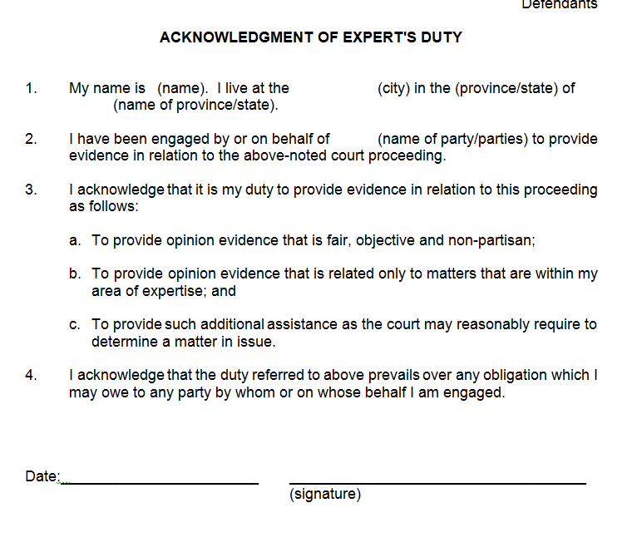
What is a Form 53?

Slide 73
Contact: jvigmond@oatleyvigmond.com Phone: 705-726-9021 Twitter: @JimVigmond

