Slide 1
Medical marijuana: the legal issues
Brian cameron, Partner

Slide 2
Topics
Brief History of Marijuana Legislation in Canada
Current Legal Regime
Role of Health Care Practitioners
How Medical Marijuana is Obtained
Law Enforcement
Notes:
Topics to Cover

Slide 3
A brief History of marijuana legislation in canada
1908 – Opium Act prohibited sale of opium
1922 – Judge Emily Murphy publishes The Black Candle, claiming marijuana turns users into homicidal maniacs.
"When coming from under the influence of (marijuana), the victims present the most horrible condition imaginable. They are dispossessed of their natural and normal willpower, and their mentality is that of idiots. If this drug is indulged to any great extent, it ends in the untimely death of its addict.”
Notes:
-The 1908 Opium Act was the first Canadian law to prohibit drugs
-followed a visit to opium dens in Vancouver by then Deputy Minister of Labour Mackenzie King
-1922 – Judge Emily Murphy writes: “When coming from under the influence of (marijuana), the victims present the most horrible condition imaginable. They are dispossessed of their natural and normal willpower, and their mentality is that of idiots. If this drug is indulged to any great extent, it ends in the untimely death of its addict.”

Slide 4
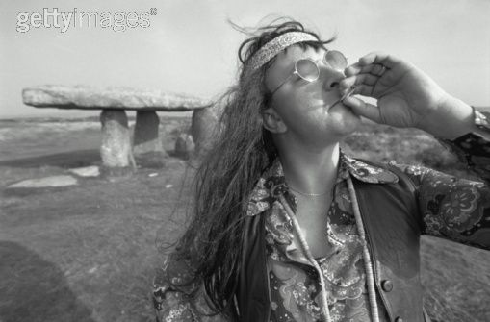
A brief History of marijuana legislation in canada
Cannabis first became illegal in Canada in 1923
Initially, enforcement was rare
Until the 1960’s, that is…
Notes:
-in 1923, the govt added marijuana to the schedule of prohibited drugs in the Opium and Narcotic Control Act
-initially, very few convictions – but by the 1960’s, enforcement was rising

Slide 5
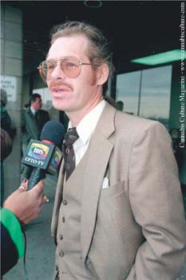
A brief History of marijuana legislation in canada
R. v. Parker (2000) – Court of Appeal rules that blanket prohibition against marijuana infringes on right to life, liberty and security of the person:
“…prohibition tells Parker that he cannot undertake a generally safe medical treatment that might be of clear benefit to him. Under the former Narcotic Control Act there was no procedure that he could effectively access that would allow him to grow or possess marijuana without threat of criminal sanction.”
Notes:
-In 2000, the Ontario Court of Appeal ruled that a blanket prohibition against marijuana infringed on Terrance Parker’s right to life, liberty and security of the person, and as such was unconstitutional
-Mr. Parker used marijuana to control his severe epileptic seizures

Slide 6
A brief History of marijuana legislation in canada
2001 – Marihuana for Medical Access Regulations
Allowed prescription growth of marijuana
Allowed authorized growers to provide marijuana
2012 – Harper government introduced mandatory minimum prison sentences for possessing specified amounts of marijuana or plants
Courts subsequently deemed law unconstitutional
2013 – Marihuana for Medical Purposes Regulations
No more personal growing of marijuana
Commercial growers only / dried marijuana only

Slide 7
A brief History of marijuana legislation in canada
2015 – City of Vancouver passed by-law forcing dispensaries (which remained illegal) to apply for licenses to operate
R. v. Smith – June 2015
Restricting legal access to dried marijuana is unconstitutional
Exemptions for cannabis oil and marijuana buds immediately issued by Ministry of Health
Allard v. Canada – February 2016
Requiring individuals to obtain marijuana only from licensed producers was unconstitutional, due to lack of “reasonable access”
Notes:
Allard decision gave govt 6 months to enact new legislation

Slide 8
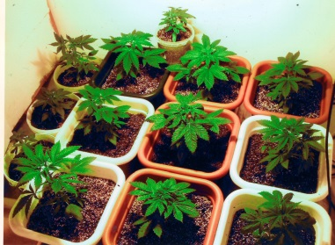
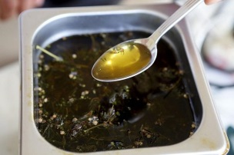
Current legal regime
Access to Cannabis for Medical Purposes Regulations (effective Aug 24/16)
A regulation under the Controlled Drugs and Substances Act
Establishes a framework for commercial production by licensed producers of quality-controlled fresh or dried marijuana, cannabis oil, or starting materials (seeds and plants)

Slide 9
Current legal regime
ACMPR also sets out provisions for individuals to produce a limited amount of cannabis for their own medical purposes, or to designate someone else to produce for them
Generally, 1 gram of dried marijuana for authorized daily use = 5 plants indoors or 2 plants outdoors
Why the distinction between indoor and outdoor plants?

Slide 10
Indoor growing

Slide 11
Outdoor growing

Slide 12
Role of health care practitioners
In Ontario, only physicians can prescribe marijuana
Notes:
Federally, nurse practitioners are also able to prescribe marijuana, but Ontario has restricted this to physicians

Slide 13
Role of health care practitioners
CPSO Policy Statement – Marijuana for Medical Purposes:
Physicians must never provide care beyond the scope of their clinical competence
Physicians are not obligated to prescribe marijuana
Physicians must carefully consider whether it is the most appropriate treatment

Slide 14
Role of health care practitioners
CPSO Policy Statement – Marijuana for Medical Purposes:
Physicians must weigh treatment options, including pharmaceutical forms of cannabinoids (Sativex, Nabilone)
Consider risks of addiction, chronic bronchitis, and onset or exacerbation of mental illness
Require patients to sign a written treatment agreement

Slide 15
Where to Legally purchase?
There are at least 30 licensed producers of marijuana in Canada

Slide 16
Where to Legally purchase?

Slide 17
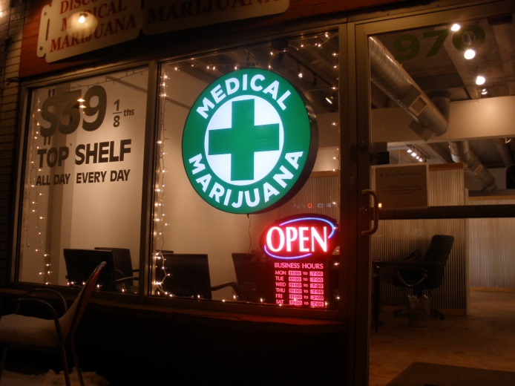
Where to Legally purchase?
Licensed producers are not the same as storefronts or “dispensaries”
Dispensaries are technically illegal in Canada, although they appear to be a relatively low priority for law enforcement action

Slide 18
Where to purchase?
Notes:
Not your typical pharmacy… and not a licensed producer – but they remain open today

Slide 19
Home growing
Must submit an application to register with Health Canada

Slide 20
Home growing
Once registered, will receive a certificate from Health Canada
Certificate includes location and maximum limits of production and storage activities, as well as possession limit

Slide 21
Home growing
Registered home producers are required to maintain and protect the security of their cannabis supply
Under ACMPR, product must be secure and inaccessible to others, including children
If producing outdoors, site must not be adjacent to a school, public playground, daycare, or other public place mainly frequented by children

Slide 22
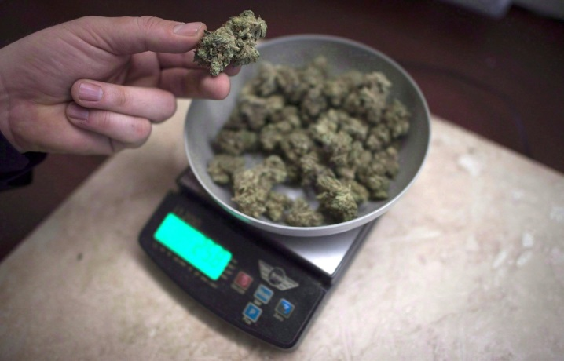
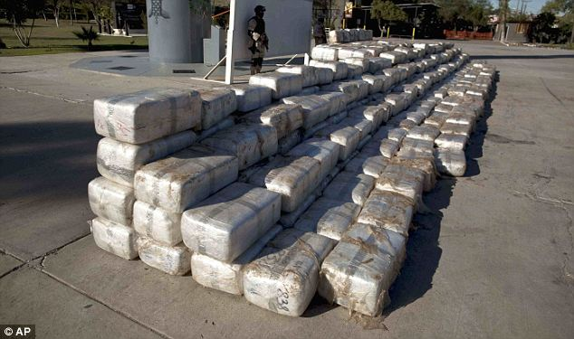
Possession limits
Under ACMPR, individual possession limit is set at the lesser of a 30-day supply, or 150 grams of dried marijuana (or the equivalent amount in another form)

Slide 23
Law enforcement
Officers can contact Health Canada to verify licensed producers and individual registrations 24 hours a day
When requested by police officer, must provide proof of registration
Remains illegal to sell, provide or give away cannabis
Remains illegal to advertise cannabis

Slide 24
Medical marijuana: the legal issues
Brian Cameron, Partner

