Slide 2
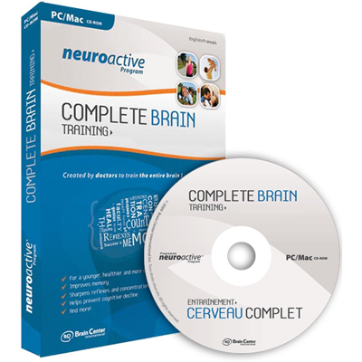
The Question: How “plastic” is the brain?

Slide 3
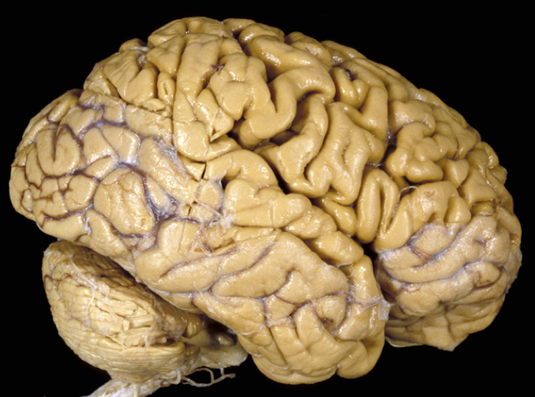
CNS (brain + spinal cord) 100-1000 billion nerve cells = neurons

Slide 4
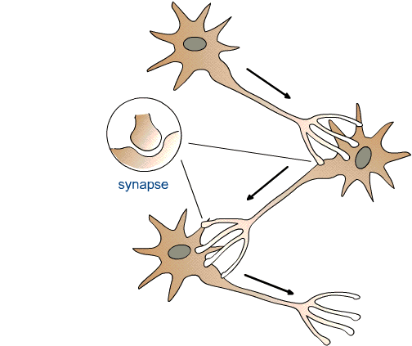
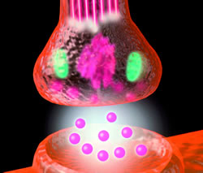
Synaptic
Communication
Chemical
Neurotransmission

Slide 5
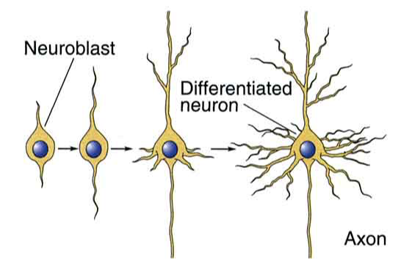
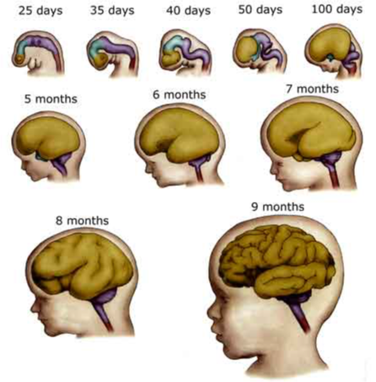
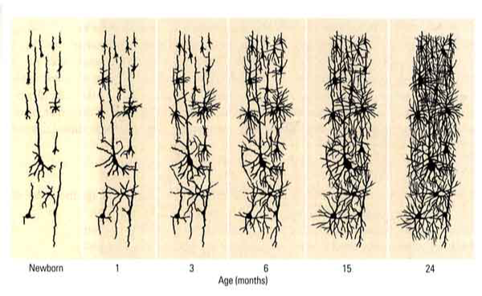

Slide 6
What is “Neuroplasticity?
The ability of the nervous system to undergo changes
in its anatomical, chemical, and physiological/functional properties.

Slide 7
1. History
How plastic is the brain?
Some historical considerations

Slide 8
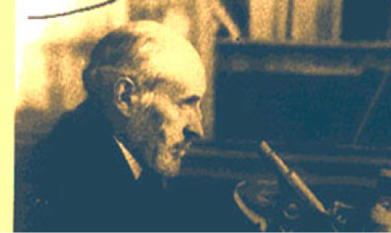
Romon y Cajal (1852-1934):
Spanish neuroanatomist and founder of modern neuroscience research
“Neuron Doctrine”
discovered dendritic spines
1906 Nobel prize with Camillo Golgi

Slide 9
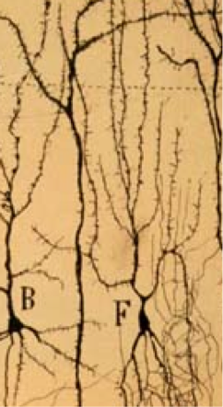
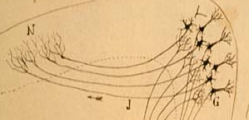
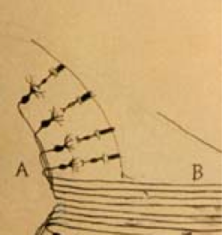

Slide 10
Cajal’s ambiguity regarding plasticity:
“proliferative inability”
“(after development)...growth and regeneration of
axons and dendrites dried up irrevocably”
“restorative plasticity”, i.e., some capacity for
plastic reorganization after brain injury
TINS 25:589 (2002)

Slide 11
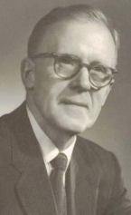
Donald O. Hebb (1904-1985)
1949

Slide 12
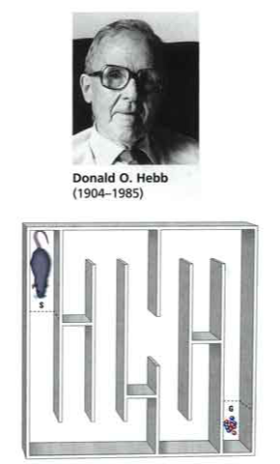
Home Rat
Lab Rat
Errors
Training Days

Slide 13
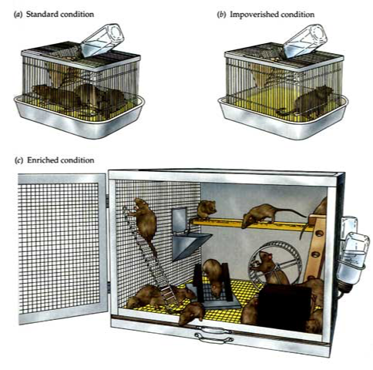
Brain plasticity: Empirical evidence

Slide 14
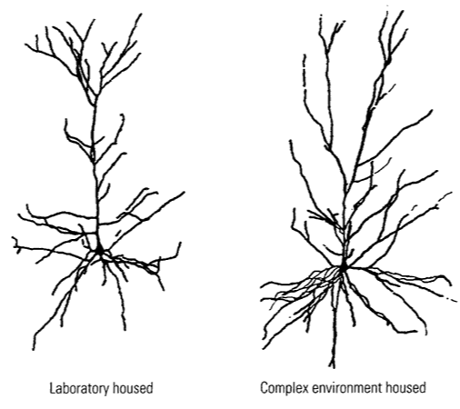

Slide 15
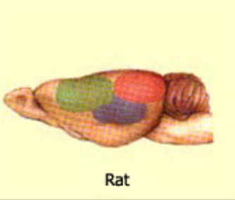
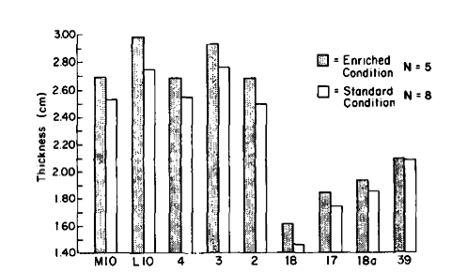
Enrichment between 766-904 days of age
Motor & Somatosensory Visual Cortex
Cortex
(Diamond et al., Exp Neurol 87; 1985)

Slide 16
Brain Structure Rearing
Cortex Thickness &Weight ER > SR > IR
Corpus Callosum Thickness ER > SR > IR
Neuron Size ER > SR > IR
Dendrite Length ER > SR > IR
Synapses/Neuron ER > SR > IR
Neurotransmitters ER > SR > IR
(e.g. Acetylcholine)
Adult Neurogenesis ER > SR > IR
Behavior Rearing
Perception (e.g.,vision) ER > SR > IR
Cognition (learning/memory) ER > SR > IR
Recovery from brain injury ER > SR > IR

Slide 17
Summary:
Research initiated in the 1960’s provided clear evidence
for structural brain plasticity. The brain responds to where we live and what we do.
The ability of the brain to change is reduced,
but not lost in advanced age!

Slide 18
2. Concepts
A theory of brain plasticity

Slide 19
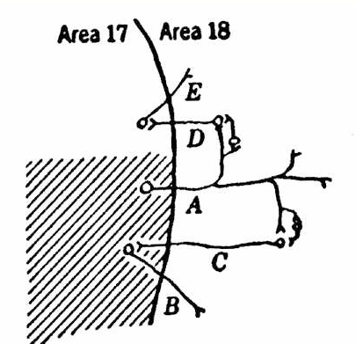
D.O. Hebb
plasticity is
- use dependent
- coincident-dependent
LIGHT

Slide 20
Neuron A
Neuron B
Synaptic strengthening
Synaptic weakening

Slide 21
3. Mechanisms
Example of neuroplasticity in action

Slide 22
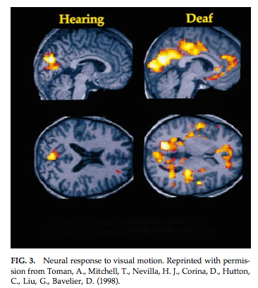
Stimulus:
Brain
Response:
or

Slide 23
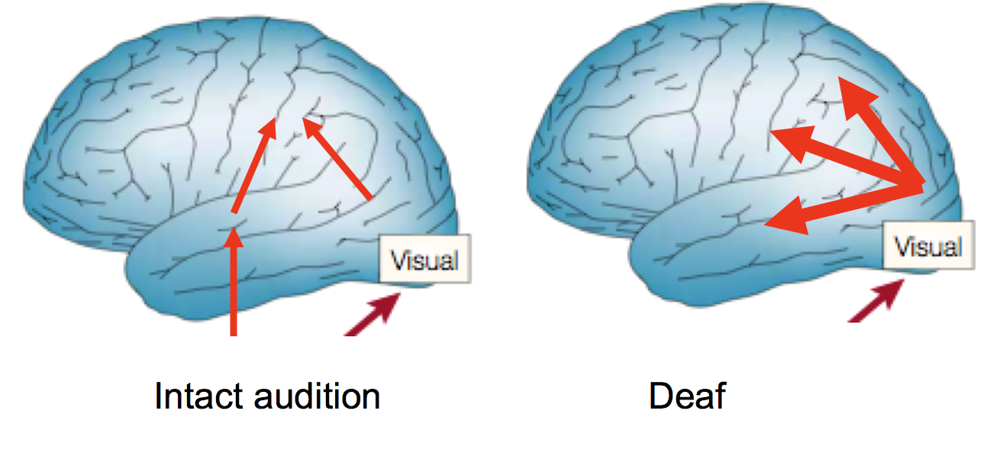
Audition
(images modified from Bavelier et al. TICS 10, 2006)

Slide 24
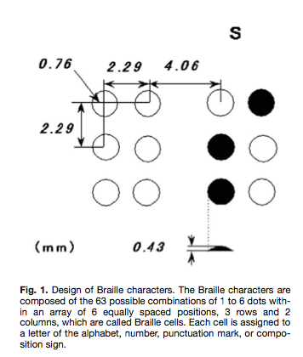
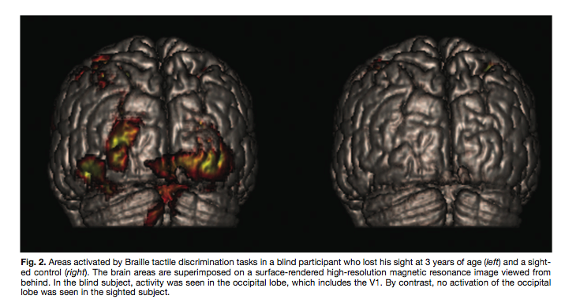
Blind Sighted
(from Sadato, The Neuroscientist 11, 2005)

Slide 25
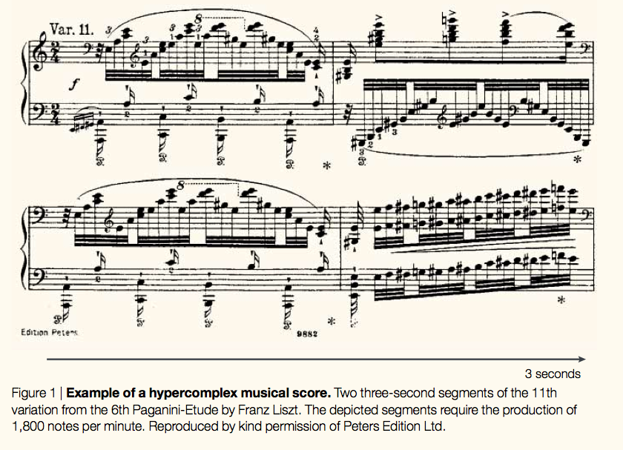
Plasticity and skill acquisition

Slide 26
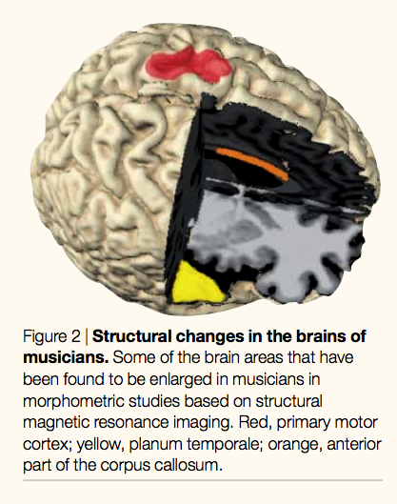
Enlargement of:
Auditory cortex
Hand representation in motor cortex
Corpus callosum
Cerebellum
(from Muente et al, Nat Rev Neurosci 3, 2002)

Slide 27
Short Training =
Small Difference
Long Training =
Larger Difference
Anatomical Changes
2 4 6 8 10 13
Years of Musical Training
(adapted from Jaencke et al, Brain & Cognition 34, 1997)

Slide 28
The fully developed human brain retains a high degree of
plasticity:
in response to sensory loss
training/learning, skill acquisition
The plasticity potential can be harnessed in order to
allow injured brains to recovery, and to optimize the
recovery process

Slide 29
4. Plasticity & the Damaged Brain

Slide 30
Right hemisphere damage in M1 -> left hand impaired
Move right hand -> focused activation in left sensorimotor cortex
Move left hand -> widespread activation of both hemispheres
=> Other brain areas start to participate in control of affected limb
(Feydy et al, Stroke 33, 2002)

Slide 32
Damage
X
Recovery by Neuroplasticity

Slide 33
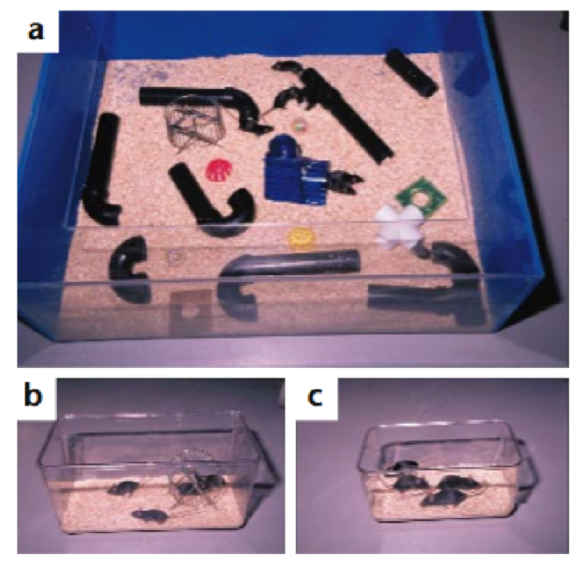
Optimal Conditions to Promote Brain Plasticity & Recovery

Slide 34
Lesion Size
Behavioural Performance
Damage
Damage +
“Therapy”
Damage
Damage +
“Therapy”

Slide 35
Factors that promote brain plasticity:
time - therapeutic intervention
motivation, reward - engagement, interest
sleep - age (younger)
pharmacology - others….
Recovery
2 4 6 12 24 36
Time from Brain Damage (Months)

Slide 36
Summary: Some Milestone in the History of Neurplasticity
1. Initial doubts regarding the ability of the adult nervous system to show plastic changes (early 1900’s)
2. Hebb establishes theoretical basis for experience-dependent brain plasticity (1930-40’s)
3. First empirical support for brain plasticity (1960’s)
4. Detailed analyses of cellular, molecular, and genetic mechanisms mediating
brain plasticity (1970’s-present)
5. Information regarding brain plasticity incorporated into applied settings (child development, eduction, medicine, rehabilitation, successful aging, etc.).

Slide 37
Supported by:
Thank You Very Much!

