Slide 1
The science and clinical management of concussion
Return to Sport After Concussion:
Paul Comper, PhD CPsych
Toronto Rehabilitation Institute – University Health Network
Co-Principal Investigator
Hull-Ellis Concussion Research Clinic
David L. MacIntosh Sports Medicine Clinic
Rehabilitation Sciences Institute
University of Toronto
National Hockey League
Players’ Association

Slide 2
Overview
Background
What is a concussion?
Signs vs. Symptoms
Challenges in Evaluation & Clinical Management
Returning to… sport… school… work…
Recovery, Treatment & Prevention

Slide 3
In North America…
Intense media coverage of (mainly) sports concussion

Slide 4
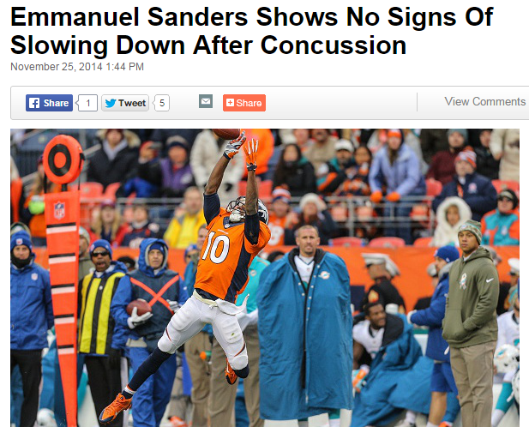
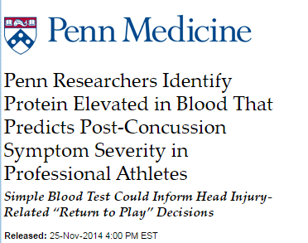
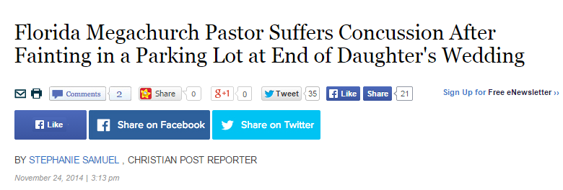

Slide 5
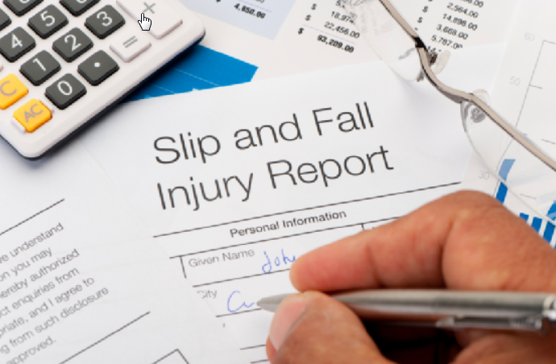
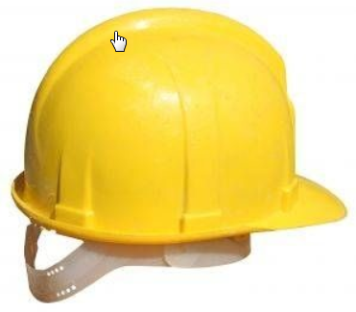
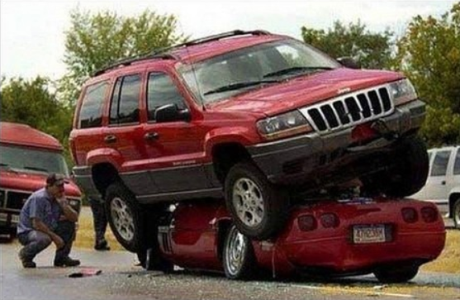
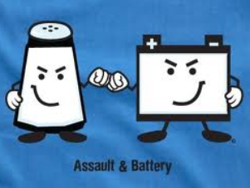
Concussions are not exclusive to sports:
Work related
Falls - #1
Assaults
MVAs - #2

Slide 6
‘Concussion’= Research

Slide 7
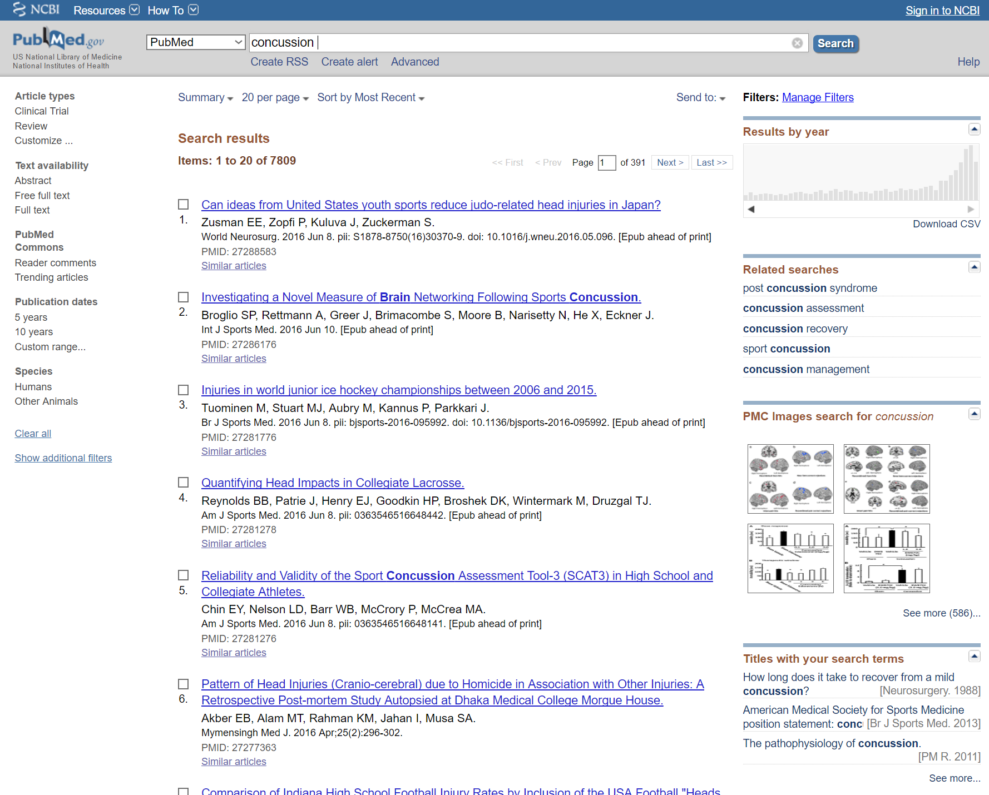

Slide 9
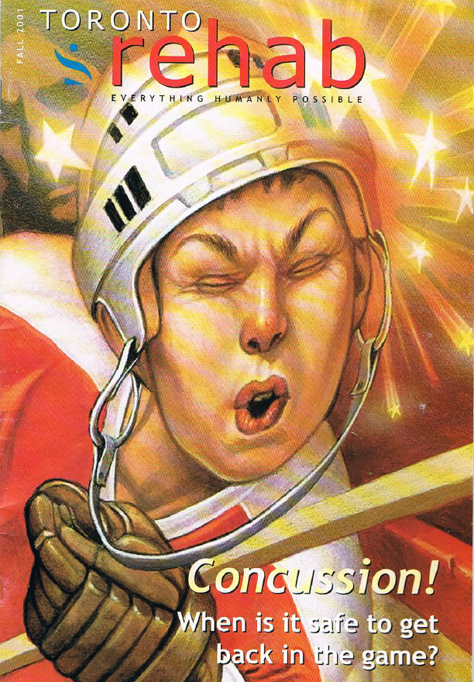
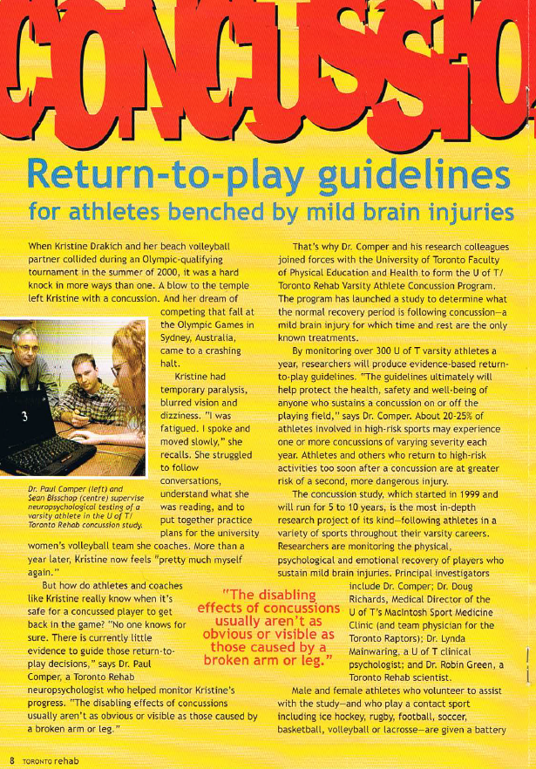
Toronto Rehab Magazine – Fall 2001

Slide 10
What is a concussion?

Slide 11
“…a complex pathophysiological process affecting the brain, induced by traumatic biomechanical forces. ”
“Zurich 2008” Br J Sports Med 2009;43:i76-i84 doi:10.1136/bjsm.2009.058248

Slide 12
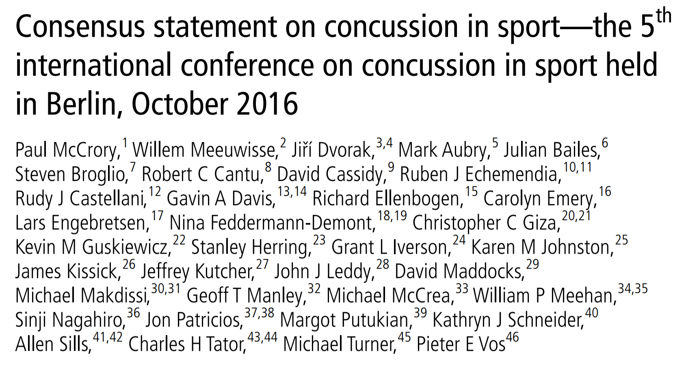

Slide 13
Sport related concussion is a traumatic brain injury induced by biomechanical forces.

Slide 14
‘Concussion’ is a type of traumatic brain injury.

Slide 15
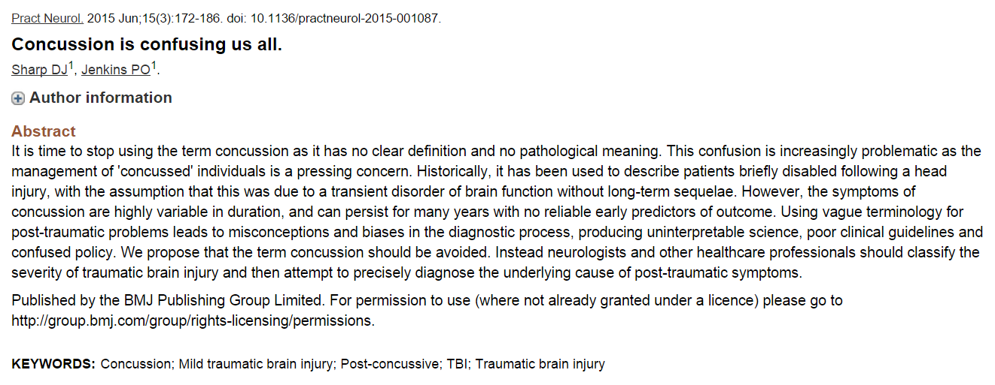
Not everyone agrees!

Slide 16
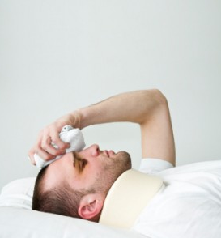
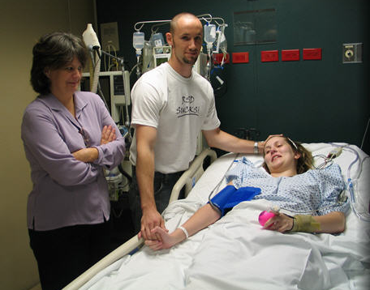
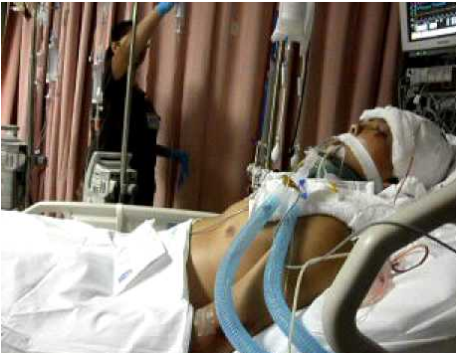
The Continuum of Traumatic Brain Injury
Negligible
Effect
Profound
Effect
‘Mild’
TBI
‘Moderate’
TBI
‘Severe’
TBI
concussion
Brief or No LOC
GCS = 13-15/15
‘Normal’ CT/MRI
Typically rapid recovery
In 15% of population, symptoms may persist
Typically but not always LOC
GCS = 9-12
Frequently CT/MRI findings
Fair to good recovery
Cognitive and behavioural symptoms typical
Most frequently LOC and coma
GCS = 3-8
Frequently CT/MRI findings
Poor to fair recovery
Cognitive and behavioural symptoms typical

Slide 17
What does a concussion look like?

Slide 18
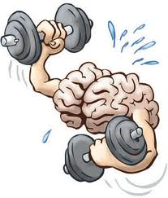
What happens?
1. Acceleration-deceleration
2. Rotational force
→ Shear nerve fibers (?)
3. Brain cells altered chemical function
Vulnerable state – minutes to days
Exact length of time remains unknown
4. During this time, brain does not function properly
and is vulnerable to subsequent injury

Slide 19
Some Visible Signs of Concussion
Loss of consciousness (lying motionless)
Obvious disorientation (momentary or prolonged)
Balance/incoordination
Slurred speech
Repetitive questions (what happened?)
Very slow to respond; appears ‘out of it’

Slide 20
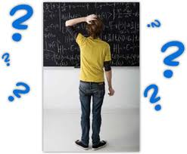
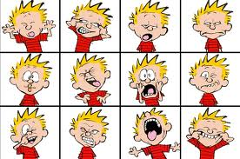
Symptoms of Concussion
Physical
Cognitive
Emotional
Headache
Nausea, feel like vomiting
Light/sound sensitivity
Not feeling “normal”
Disorientation/dazed
Difficulty concentrating
More forgetful
Excessively irritable
Depression
Anxiety

Slide 21
Challenges in Evaluation and Management
Most concussions do not involve a loss of consciousness.
A concussion can occur without direct head trauma.
Brain imaging is ‘normal’ almost 100% of the time.
There are no gold-standard diagnostic ‘tests’ for concussion. The clinician is largely dependent on self-report of symptoms by the patient

Slide 22
Characteristics of Concussion in a Sample of High School Students*
Mechanism of injury
Direct head trauma
Yes = 79%, No = 7%, Unsure = 14%
Athlete motion
Yes = 64%, No = 17%, Unsure = 19%
LOC and amnesia
LOC
None = 86%, Certain = 4%, Suspected = 10%
Amnesia
Pre-Trauma
(No=1%; Patchy=14%)
LOC (4%)
Post-Trauma
(No=2%; Patchy=21%)
*Comper, Hutchison & Richards, 2016

Slide 23
Recovery from Concussion:
Most of the symptoms of concussion spontaneously resolve within 7-14-28 days. (approx. 85% of people)
A minority of people with concussions will experience prolonged symptom duration – PCS - (10-15%).
Recovery times can vary depending on many factors, e.g., age, number of prior concussions or other neurological history, male vs. female, history of learning challenges and history of mood disorder.
Currently no way of accurately predicting who will/will not recover quickly.

Slide 24
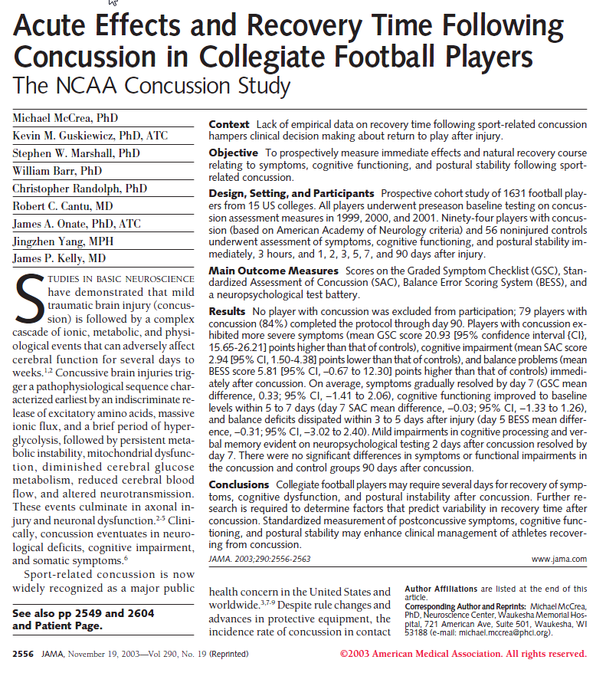
JAMA, 2003: 290: 2556-2563
1631 NCAA football players
2410 player-seasons over 3 years
Control subjects matched to injured players (n=56)
Concussed players n = 94
LOC < 30 sec. = 6.4%
No LOC, amnesia for 77%
Persistent symptoms in 10%

Slide 25
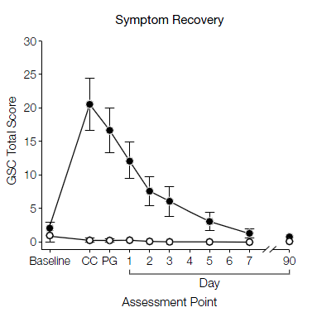
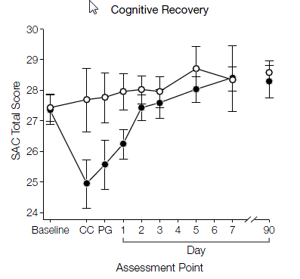
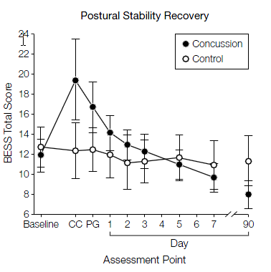
From: Acute Effects and Recovery Time Following Concussion in Collegiate Football Players: The NCAA Concussion Study
JAMA. 2003;290(19):2556-2563. doi:10.1001/jama.290.19.2556
Figure Legend:
Higher scores on the Graded Symptom Checklist (GSC) indicate more severe symptoms; lower scores on the Standardized Assessment of Concussion(SAC) indicate poorer cognitive performance; and higher scores on the Balance Error Scoring System (BESS) indicate poorer postural stability. Error bars indicate 95% confidence intervals. CC indicates time of concussion; PG, postgame/post-practice. On the BESS, multiple imputation was used to estimate means and 95% confidence intervals for control participants for the CC and PG assessments.
Copyright © 2012 American Medical Association. All rights reserved.

Slide 27
Source: Comper, Hutchison & Richards, The MacIntosh Sports Medicine Clinic – University of Toronto, 2014

Slide 28
Possible Risk Factors for delayed recovery
Prior history of concussion(s) or other neurological disorder;
Migraine;
History of mood disorder (e.g., anxiety & depression);
Academic (i.e., learning) difficulties;
Significant pre-existing psychosocial issues.

Slide 29
Treatment & Prevention

Slide 30
Only a very small percentage of concussion research articles deal with treatment interventions
Why?

Slide 31
Reason #1.
Most people who suffer 1st concussions (~80 – 85%) fully recover without any intervention whatsoever, within a finite period of time.

Slide 32
Reason #2.
“Concussion” is not a uniform disorder and each person’s response to concussion is unique.
So what do we know about treatment of concussions?
Notes:
Mention here, small sample sizes, lack of controls and the main reason there is little research: no ability to ethically do prospective randomized control studies. You just can’t assign people to a controlled head injury group and then drop a weight on their heads. We tried proposing this but it didn’t get past the dean.

Slide 33
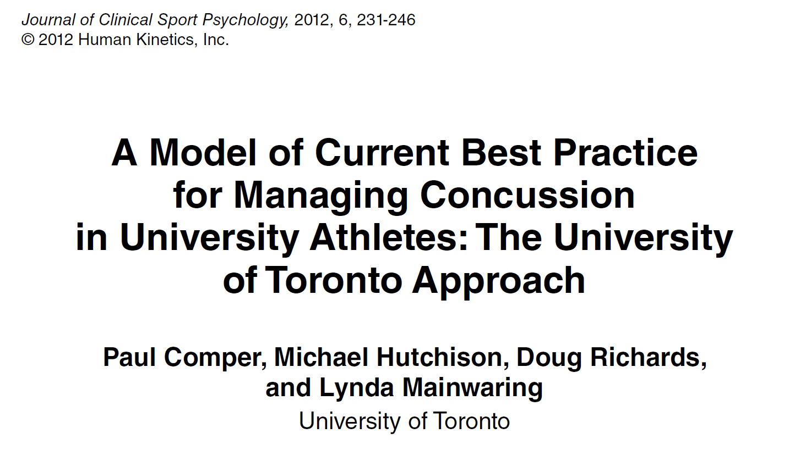
“Unfortunately, there is no ‘magic bullet’ to cure concussions.”

Slide 34
In the post-injury phase, there are currently two accepted ‘treatments’ for concussion:
Rest
Education
Notes:
Neither of these is actually an active ‘treatment’ as much as they are supportive modalities.

Slide 35
Rest

Slide 36
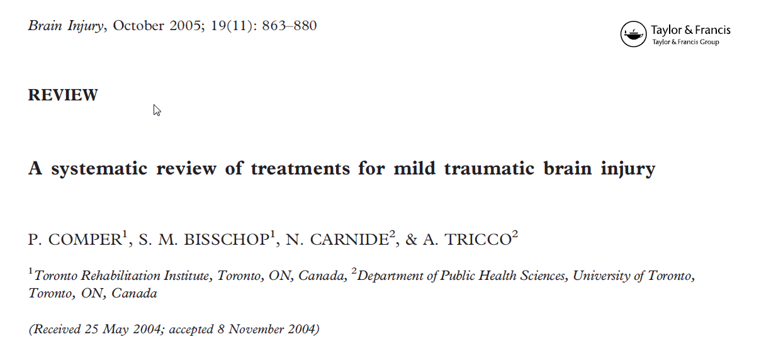
“In most studies, simple education and support appeared to benefit individuals with MTBI with respect to somatic and psychological complaints”

Slide 37
Education
Done early and repeatedly (e.g., in the ER, at the doctor’s office, clinic, etc.);
Promotes ‘normalization’ of symptoms;
Reassurance that typical symptoms are not unusual or weird (“I thought I was going crazy”);
Allows for natural recovery to occur without pressure of external expectations.

Slide 38
Symptomatic treatment might involve:
Medication for headache, sleep disturbance;
Vestibular therapy for dizziness;
Manual mobilization for neck pain/headaches;
Antidepressants/ anxiolitics for mood disturbance;
Cognitive Behavioural Therapy (i.e, counselling).
Exercise (everything old is new again)
Ideally, delivered in an interdisciplinary setting.

Slide 39
Many ‘alternative’ concussion treatments are offered to the public with no efficacy, often at great cost.
Notes:
Neither of these is actually an active ‘treatment’ as much as they are supportive modalities.

Slide 40
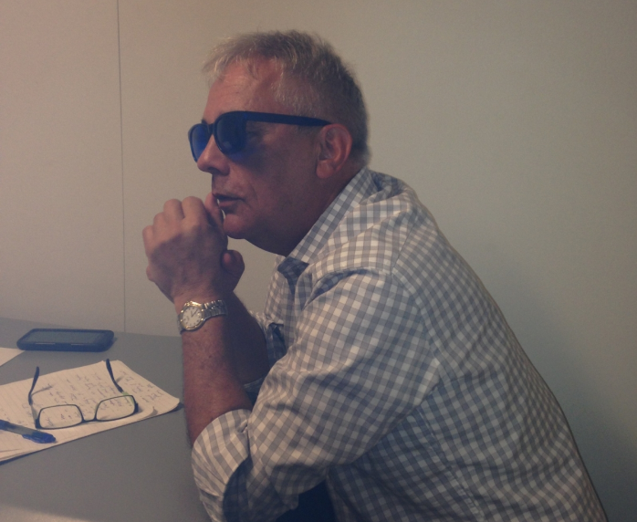
PC in his cool anti-concussion shades

Slide 41
When to Return to… sport…school, work, hobbies, etc. following concussion?

Slide 42
Generally speaking, return to anything following concussion is:
Based on the person’s functional recovery
Are symptoms still present?
At what frequency and what level?
Can the person exercise without significant provocation of symptoms?
Is there any indication of any other medical/psychological condition to account for the symptoms? (e.g., neck dysfunction, GAD)?
Is the patient neurologically ‘normal’?

Slide 43
Some evidence that clinical recovery occurs before physiological recovery, so…
If returning to sport
Initial period of rest (24-48 hours); and significant reduction in symptom burden
Gradual introduction to exercise at increasing levels, at 24 hour intervals (6 intervals, so minimum 7-8 days)
If symptoms provoked at any level, wait one day and then return to the plan.
No more “dark room” therapy
No more “total rest until asymptomatic”

Slide 44
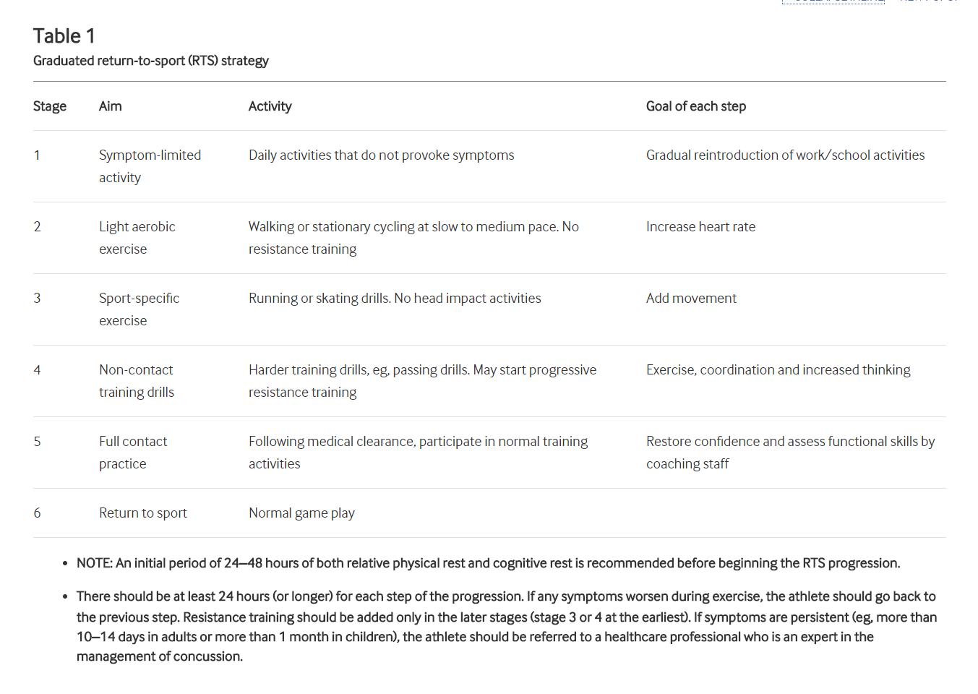

Slide 45
Caveats & Cautions
If returning to sport
Numerous prior concussions with increasing symptom burden each occurrence = BAD
Non-removal from play when symptomatic = BAD
Advice?
Consider retirement from sport (especially contact sports)

Slide 46
Concussion ‘prevention’ devices should be carefully scrutinized for claims.
Notes:
Neither of these is actually an active ‘treatment’ as much as they are supportive modalities.

Slide 47
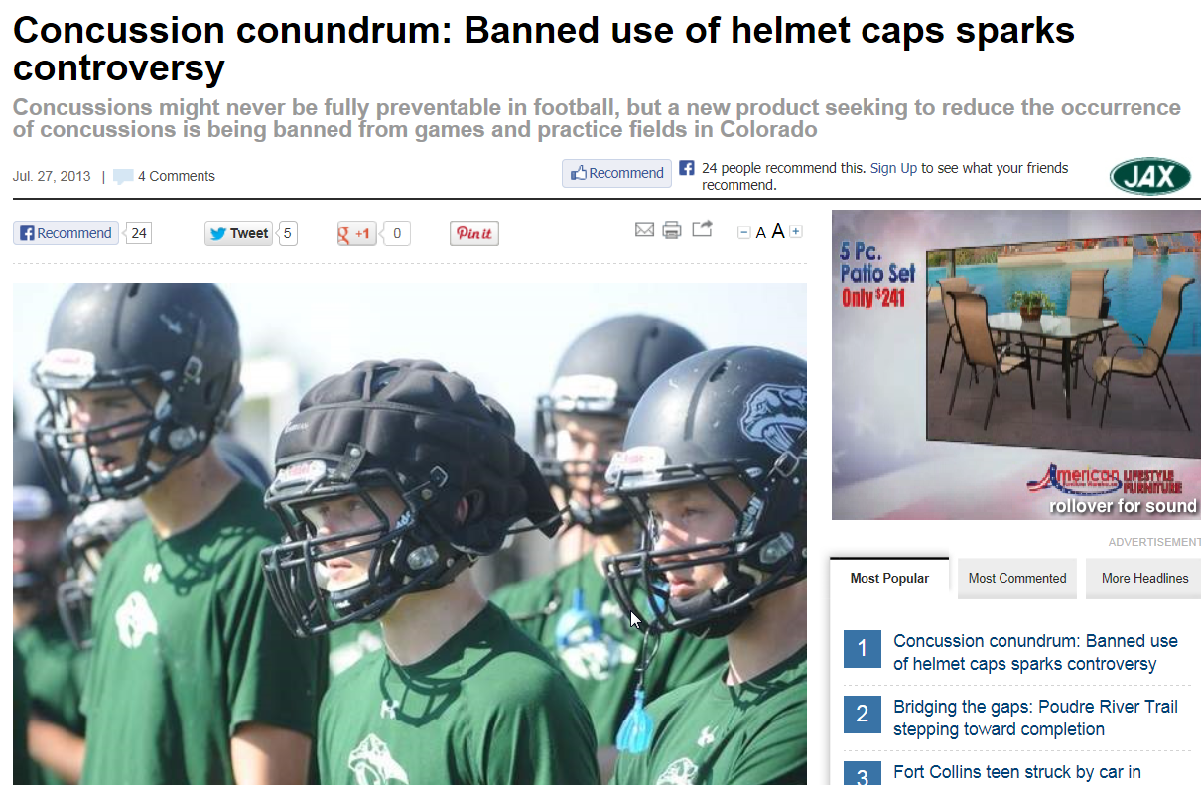

Slide 48
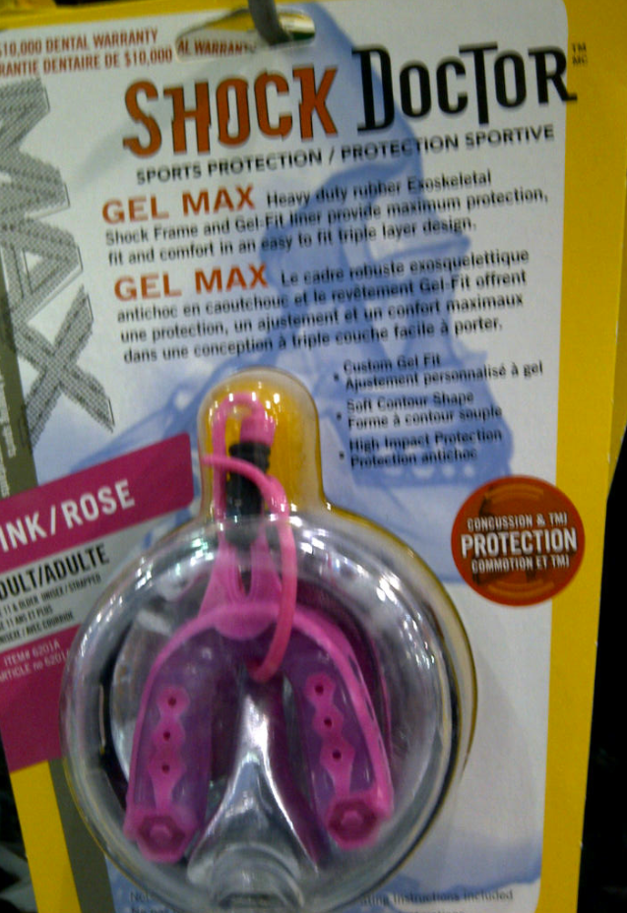

Slide 49
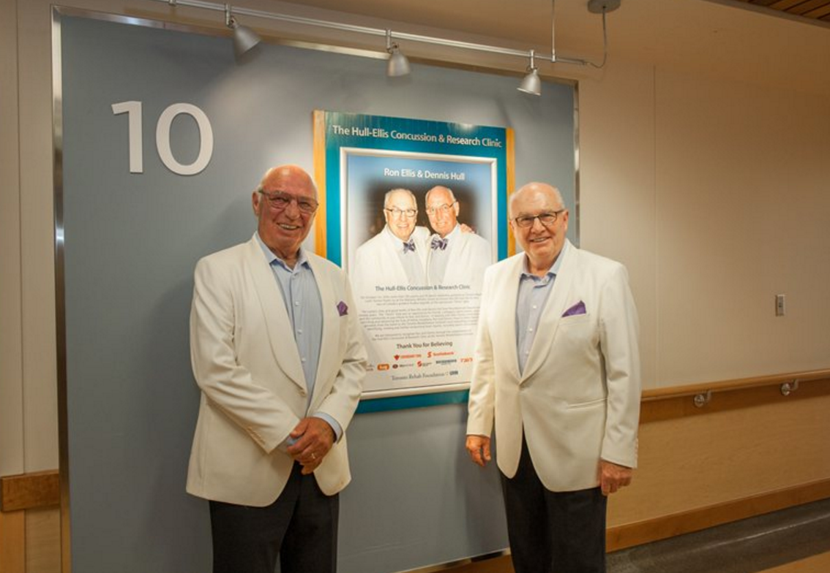
Thank You!

